Slide 1
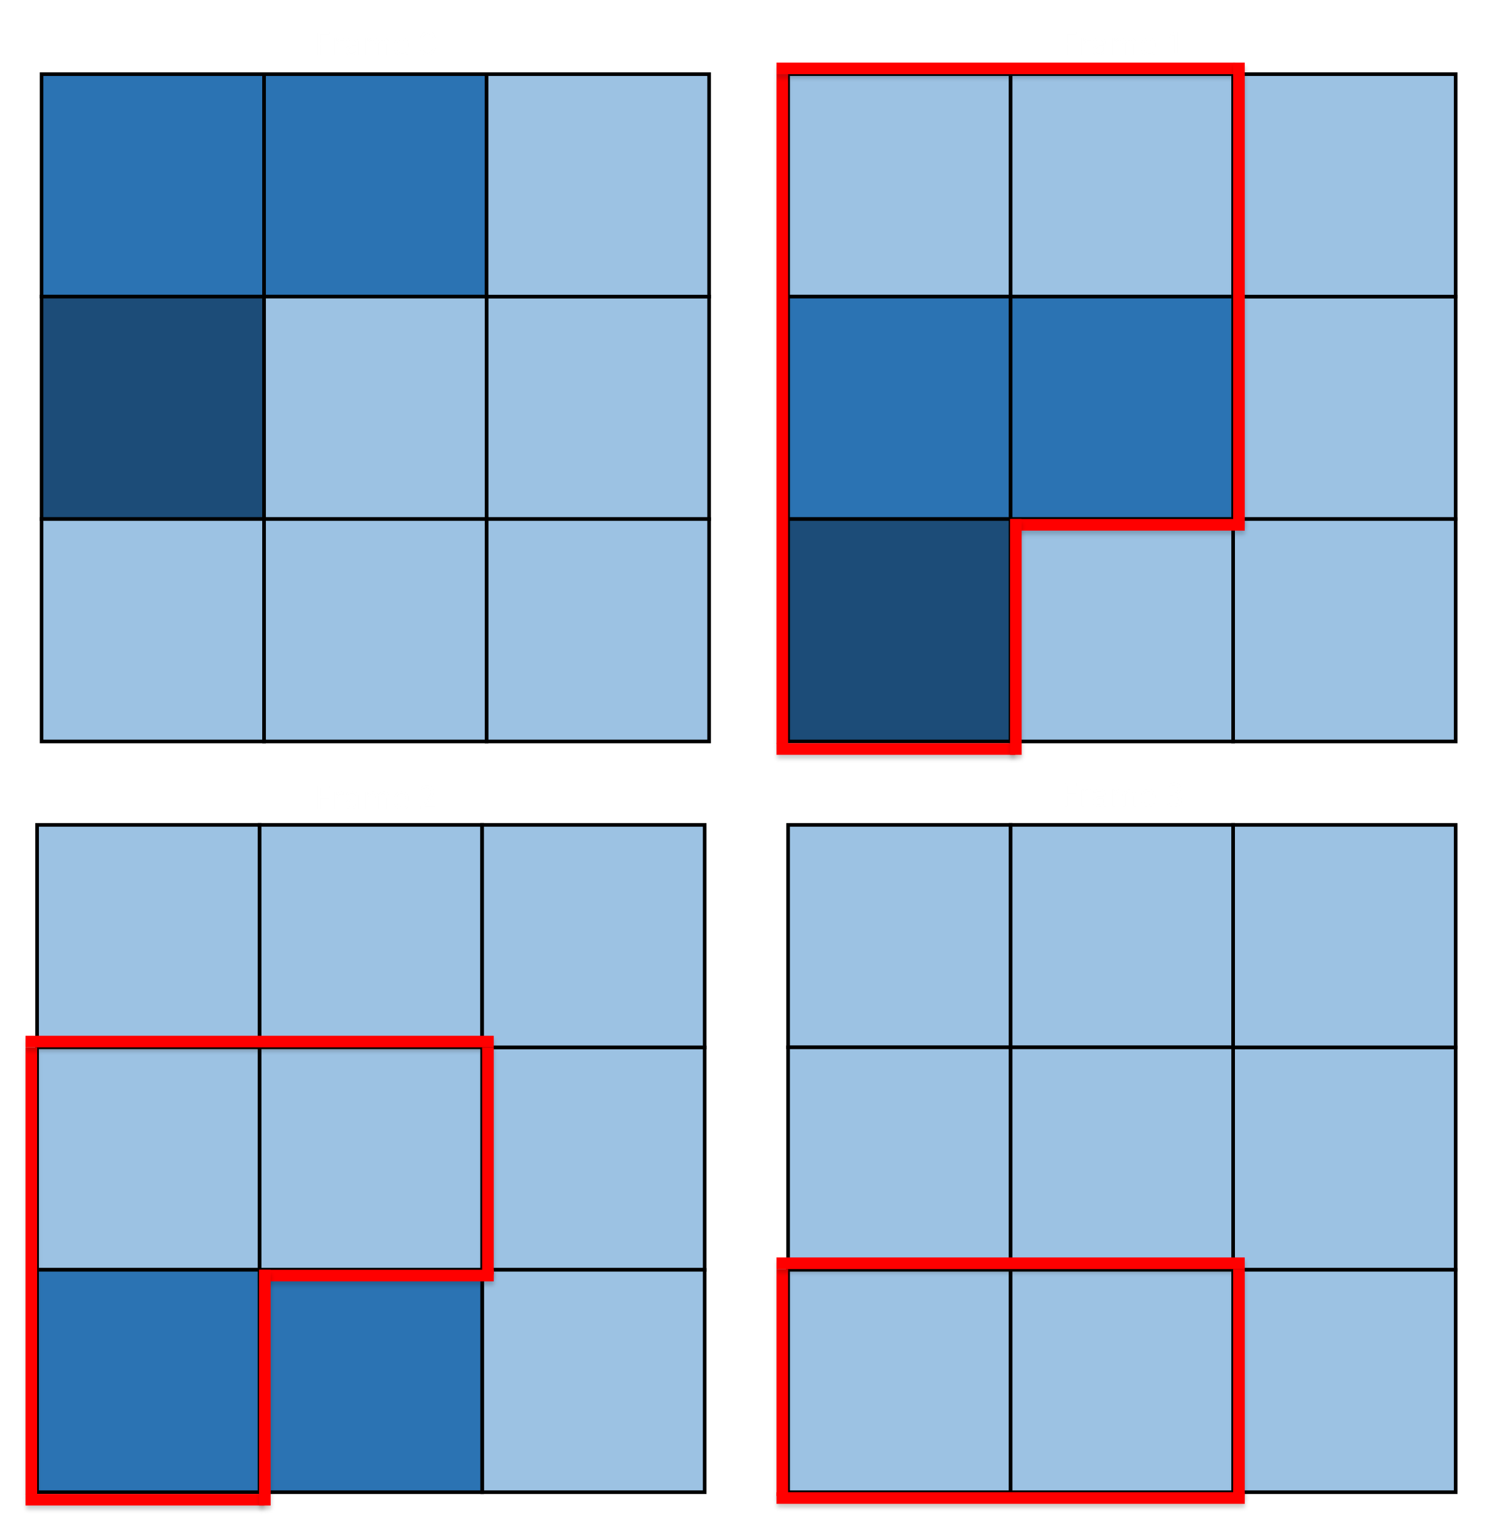
A Packetized Display Protocol for Infrared Scene Projection Systems
By Aaron Landwehr
Committee:
Dr. Fouad Kiamilev, Dr. Chase Cotton,
Dr. Xiaoming Li, and Dr. Stéphane Zuckerman

Slide 2
Background
Infrared Scene Projectors

Slide 3
Infrared Scene Projectors (IRSP)
Used to test infrared guidance systems
Must be able to produce room-temperature and hot scenery simultaneously
Higher maximum apparent temperature is almost always better
Ideally at least as fast/high resolution as the sensors (preferably twice as big as the sensor)
Often used in real time simulations

Slide 4
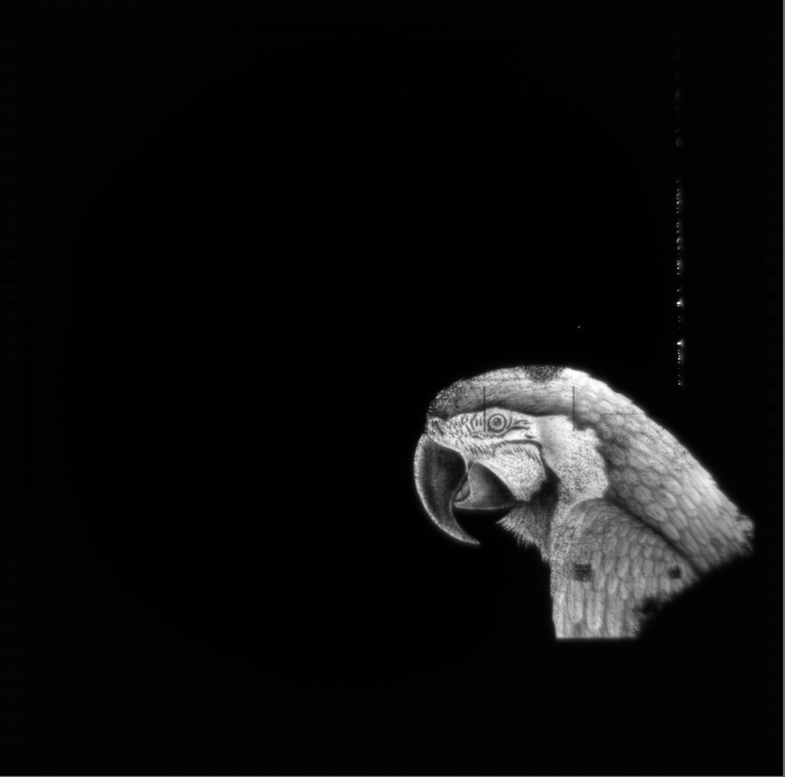
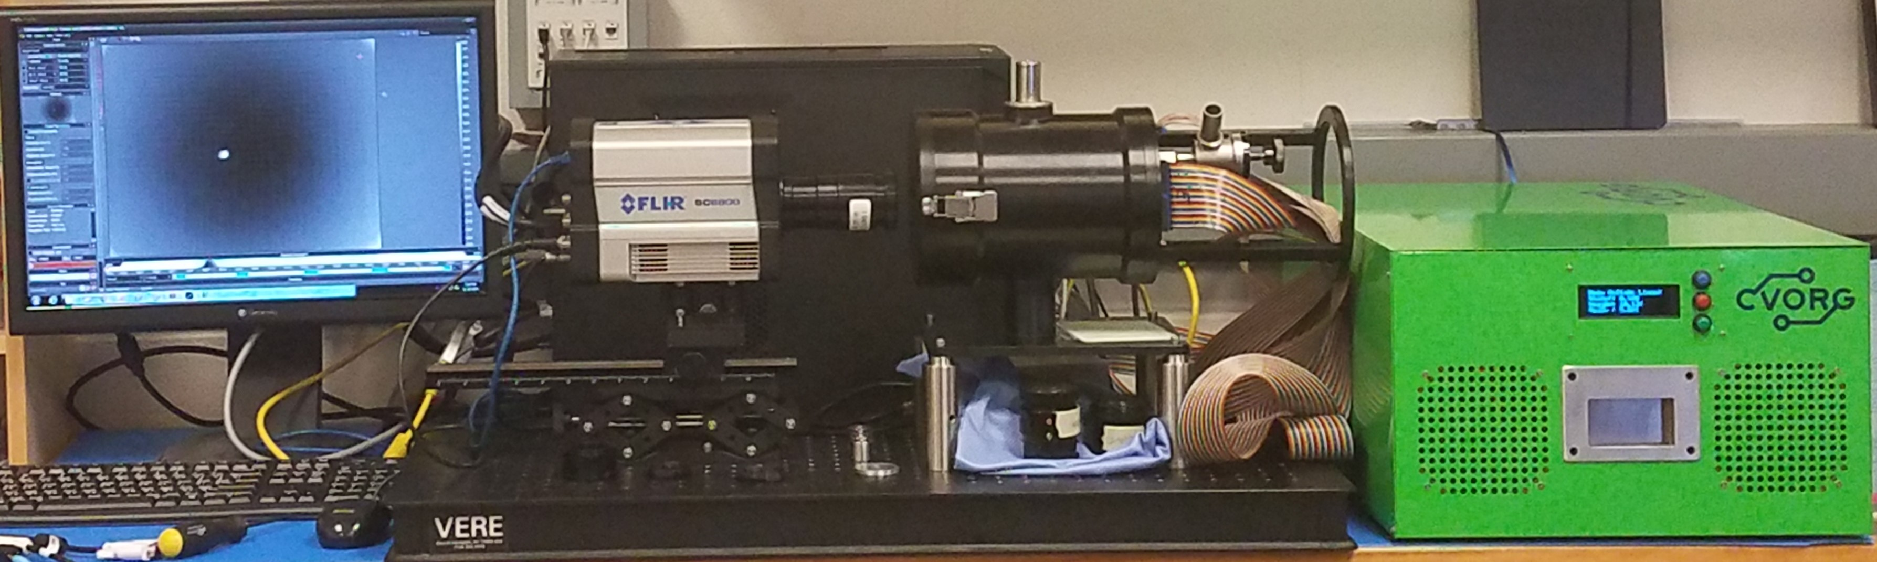
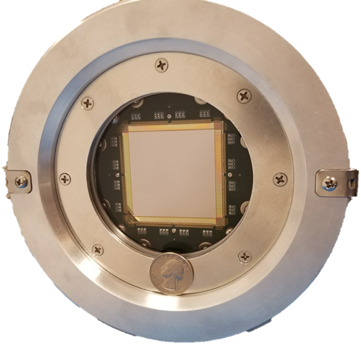
IRLED Scene Projector System
Scene Gen.
1
drive array
2
3
4
SLEDS Hybrid
5
NUC
CSE
Dewar
RIIC
IRLED Array
1
2
6
*
5
4
3
* Not Shown

Slide 5
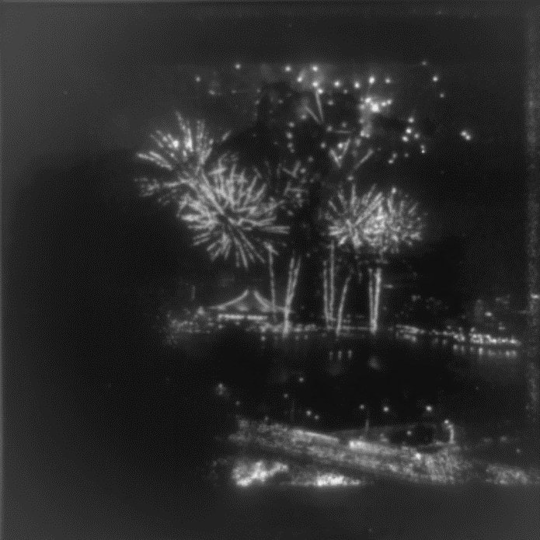
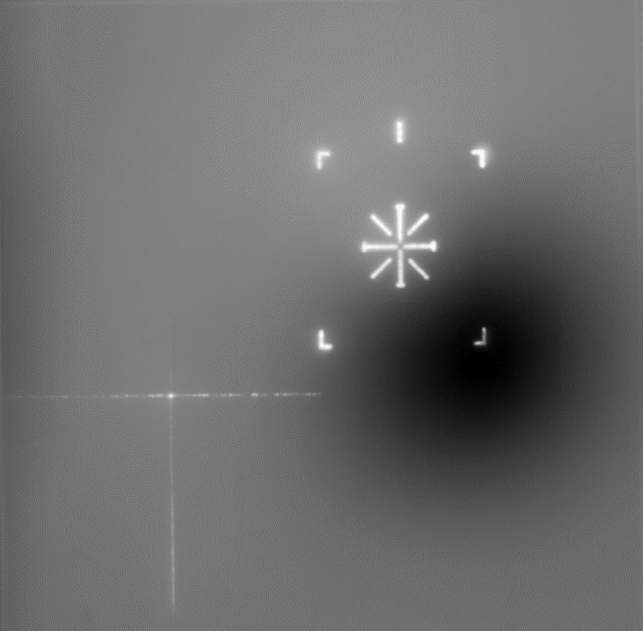
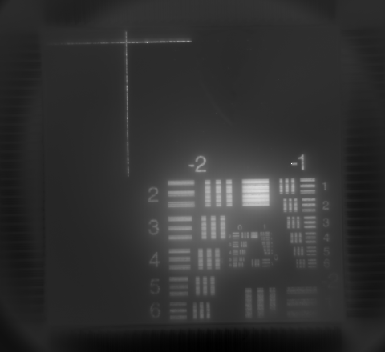
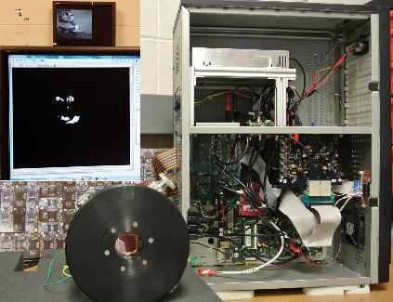
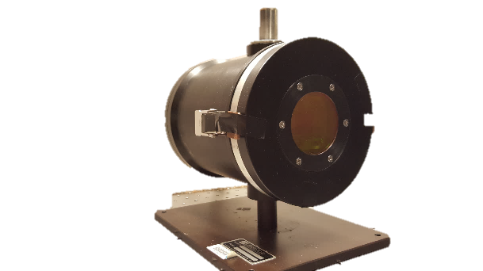
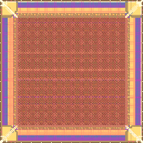

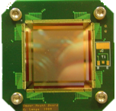
IRLED Scene Projector Technology Development Timeline Overview
512 x 512 SLEDs array + RIIC +
System to drive array
TCSA: Projector with 512 x 512 2-color SLEDs array
HDILED: Projector with 2K x 2K SLEDs array
System to drive SLEDs array
68 x 68 SLEDs array + RIIC
NSLEDS: Projector with 1K x 1K SLEDs array
2008 | 2011 | 2014 | 2016 | 2018

Slide 6
SLEDs Array Pixel Ratios
HDILED
NSLEDS
TCSA
512
512
1024
1024
2048
2048

Slide 7
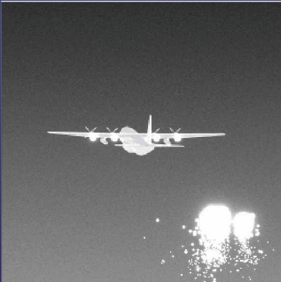
Typical IRLED Projection Process
100hz
100hz
100hz
100hz
100hz
Scene-Generation
Non-Uniformity Correction/ Reordering
Digital to Analog Conversion
Projection

Slide 8
Problem Formulation
Problem statement
Limitations
Problem Solution

Slide 9
Problem Statement
IRSP systems need to be capable of operating at high speeds with large resolutions to meet the needs of the sensor testing community.
High frame-rates (1Khz, 2Khz, …)
Large resolutions (1024x1024, 2048x2048, …)
Sub-frame latency
To reach these speeds is not possible with hardware alone.

Slide 10
Hardware Limitations
Limitations:
Physical Bandwidth Limitations
Latency
IC Clock Rates
Analog Settling Times
Large fanout of signals needed to drive arrays

Slide 11
Software Limitations
Computational Limitations (Particularly with single end-points)
Algorithmic Speeds (Non-uniformity correction, etc.)
Poor optimized drivers
Lack of driver control with display protocols (fixed frame-rate, frame drops, scalability issues)

Slide 12
Bandwidth requirements of a conventional display protocol
bandwidth | = resolution x bits x fps
bandwidth resolution bits fps | : bandwidth requirements in bits per second. : number of pixels including porches. : bits per pixel. : frames per second.

Slide 13
Possible Solutions
Utilize Off-the-shelf Protocols:
Take control of a complete end-to-end system.
Off the shelf protocols and hardware.
Develop custom hardware and software to make “off the shelf” components behave to meet system requirements.
Limitations:
Difficult to have low latency due to required buffering of entire frames
Implementation and integration-costs
System specific – upgrades or other systems require re-inventing the wheel
Design Hardware/Protocols specifically for high-speed IRLED operation Steps
Work outside of the realm of “Display Protocols”

Slide 14
Toward a Problem Solution
How to architect a dynamic scalable IRLED projection end-to-end system capable of
High-performance operation → Control over bandwidth utilization and computation
Sub-frame latency → Control synchronization
Dynamic frame-rates → Control the sending of pixels/data
Efficient Bandwidth utilization → Send only pixels needed
Efficient DAC utilization → Address only pixels needed
Upgradeability / Generalizability → Don’t tie design to specific hardware

Slide 15
Proposed Solution: Packetized Display Protocol (PDP) Architecture
Summary:
A physical layer agnostic method of pixel data transmission capable of providing and addressing latency guarantees while maximizing bandwidth utilization
Capable of
Fine-grained control over frame transmission and synchronization
Dynamic changing frame-rates from frame-to-frame
Dynamic sub-frame framerates
Fast decoding/processing
Random Access Writes
Aspects
Communication layer + Organization layer

Slide 16

Examples of Multi-frame Rate Operation
Legend:
- Red operates at 500hz - Blue operates at 20hz
High Speed
Medium Speed
Low Speed

Slide 17
Dynamic frame rate display with multiple regions updating at different frame rates

Slide 18
System Overview
SLEDS
CSE
Communication Setups

Slide 19
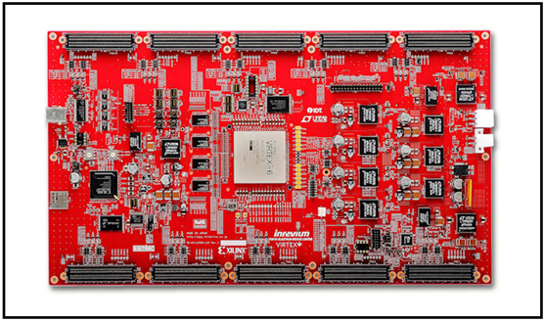
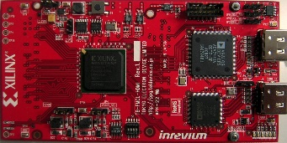
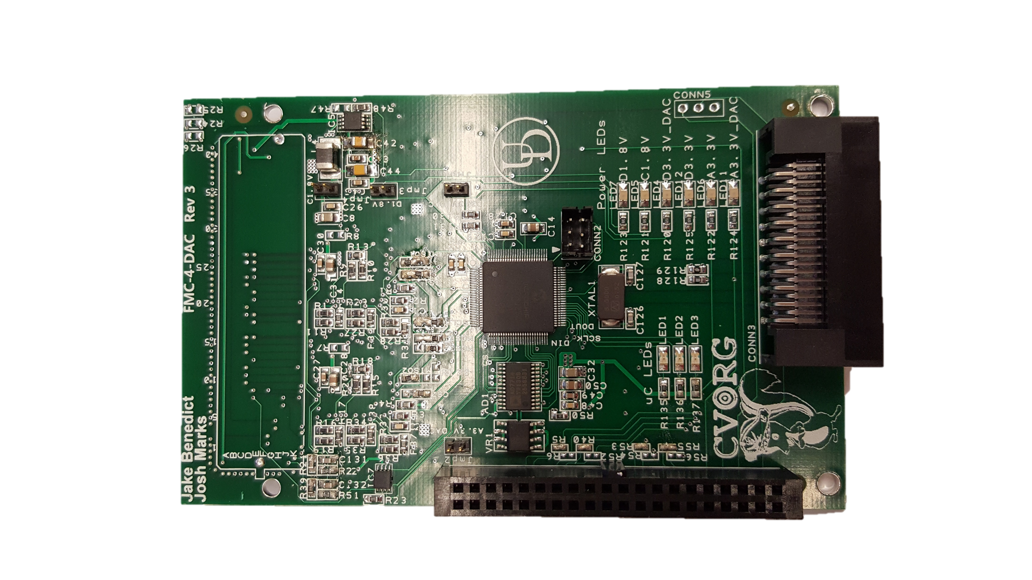
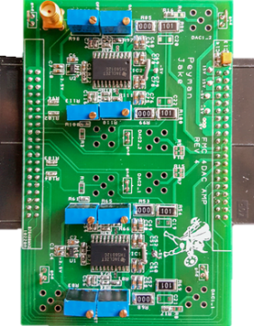
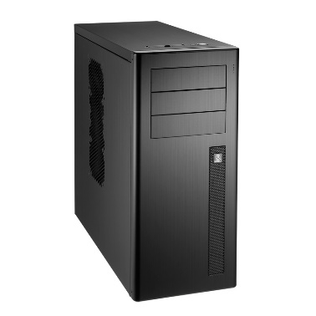
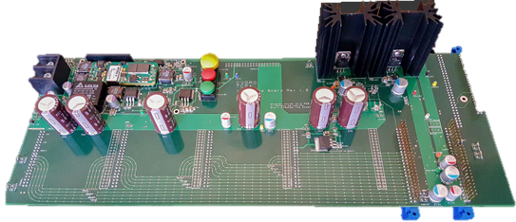

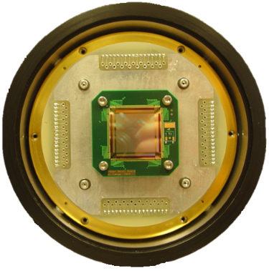
SLEDS System Block Diagram
FPGA Main Board with 10 FMC Slots
CSE Control Box
/ NUC System
Scene Generator
System
8x DAC Cards
8x Amp Cards
HDMI INPUT 1
HDMI INPUT 2
Dewar – RIIC
Hybrid Array
2x Interface Board
Close Support Electronics

Slide 20
CSE External Direct Communication Block Diagram
Scene Generator
API Communication
CSE
CSE Operation
APIs
Signaling
Array
Scene Data
Scene Generation
LPC FMC
Scene Data
LPC FMC
DVI|HDMI|DP|ARNIC 818
Fiber (in development)

Slide 21
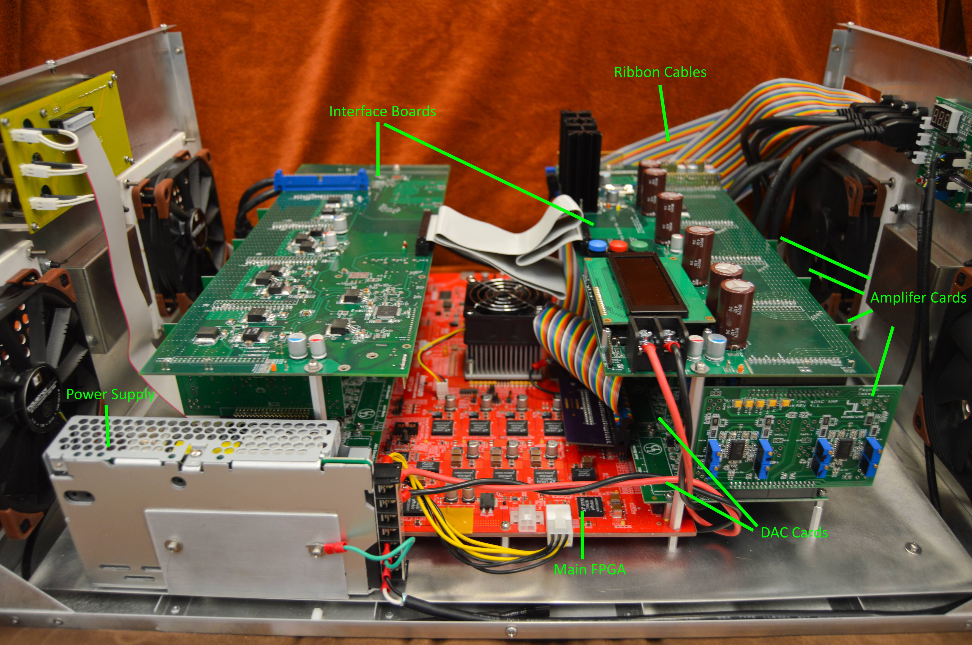
CSE Internals

Slide 22
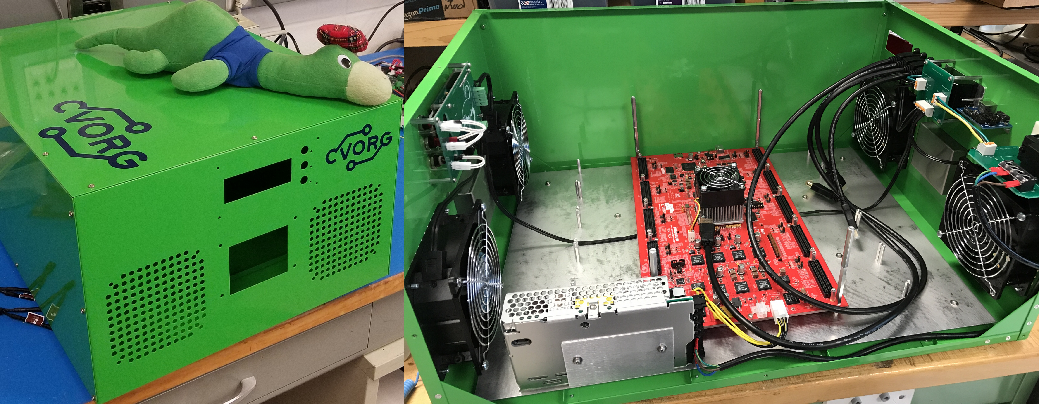
CSE Externals and Empty Chassis

Slide 23
Display Protocols
Timing
Synchronization

Slide 24
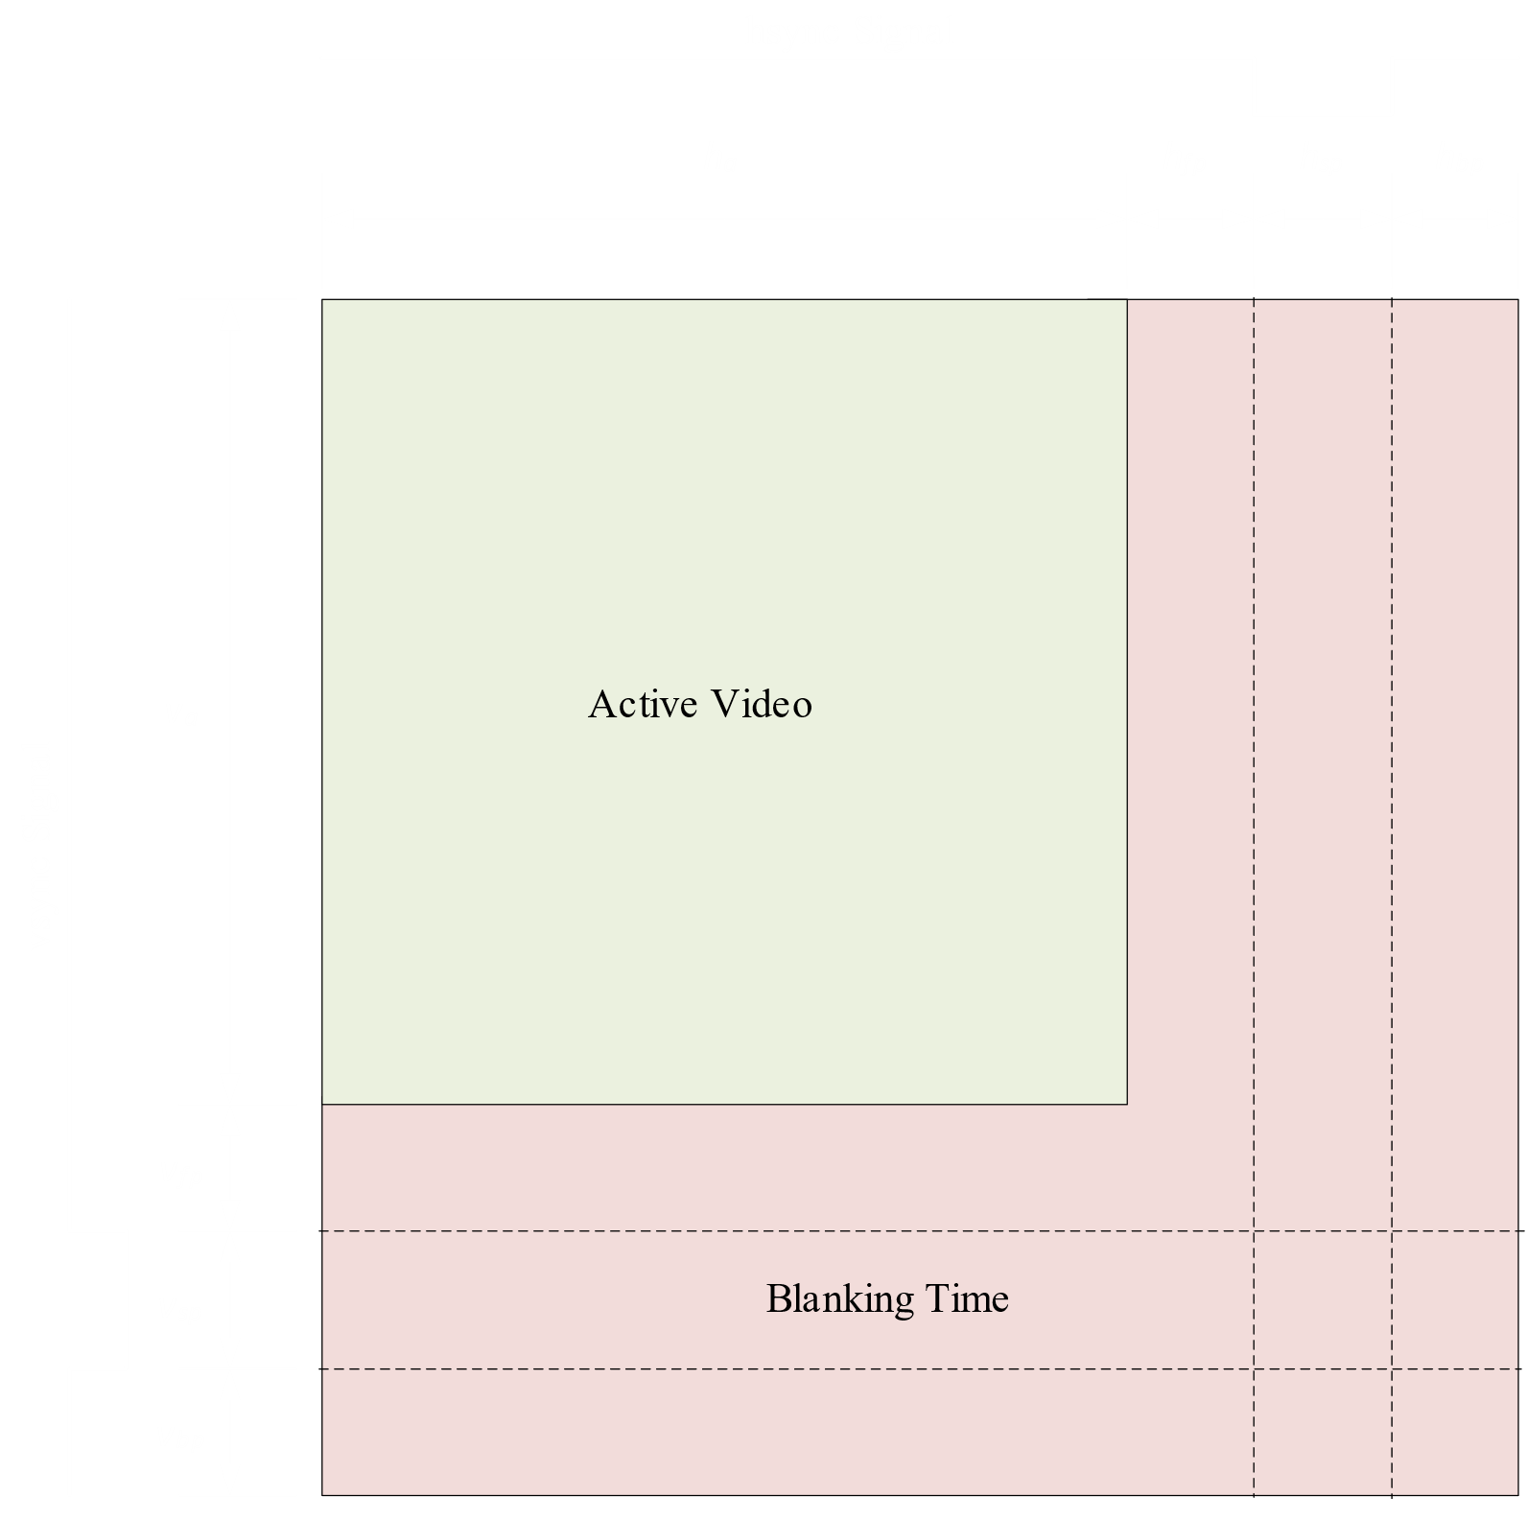
Display Protocol Timing
VGA, HDMI, etc. Work this way.
DisplayPort Kind of works this way (more on that later).
From analog video days
Lots of time spent on blanking (more on that later)

Slide 25

Display Protocol Timing
VGA, HDMI, etc. Work this way.
DisplayPort Kind of works this way (more on that later).
From analog video days
Lots of time spent on blanking (more on that later)

Slide 26

Modelines (VESA Coordinated Timing)

Slide 27
Custom Sync
Lack of control over Frame drops
Each component needs explicit synchronization
Often Requires Buffering Frames
Scene Gen.
NUC
SLEDS Hybrid
Custom Sync Solution
CSE
Dewar
RIIC
IRLED Array
Camera

Slide 28
Packetized Display Protocol
Design Methodology
Modeline Overheads
DisplayPort Framing
Packets
PDP Overhead
Multi-frame Rate Bandwidth

Slide 29
Design Methodology
To design a scalable display system that is distributable and hardware agnostic.
To provide a protocol that is relatively simple to implement without unnecessary complexity to ease the encoding and decoding process
To provide dynamic intra-frame variable refresh rate (VRR) in order to enable better bandwidth utilization.
To provide a path to utilize conventional display protocol streams such as HDMI as a backwards compatible transport layer for the PDP without introducing overhead

Slide 30
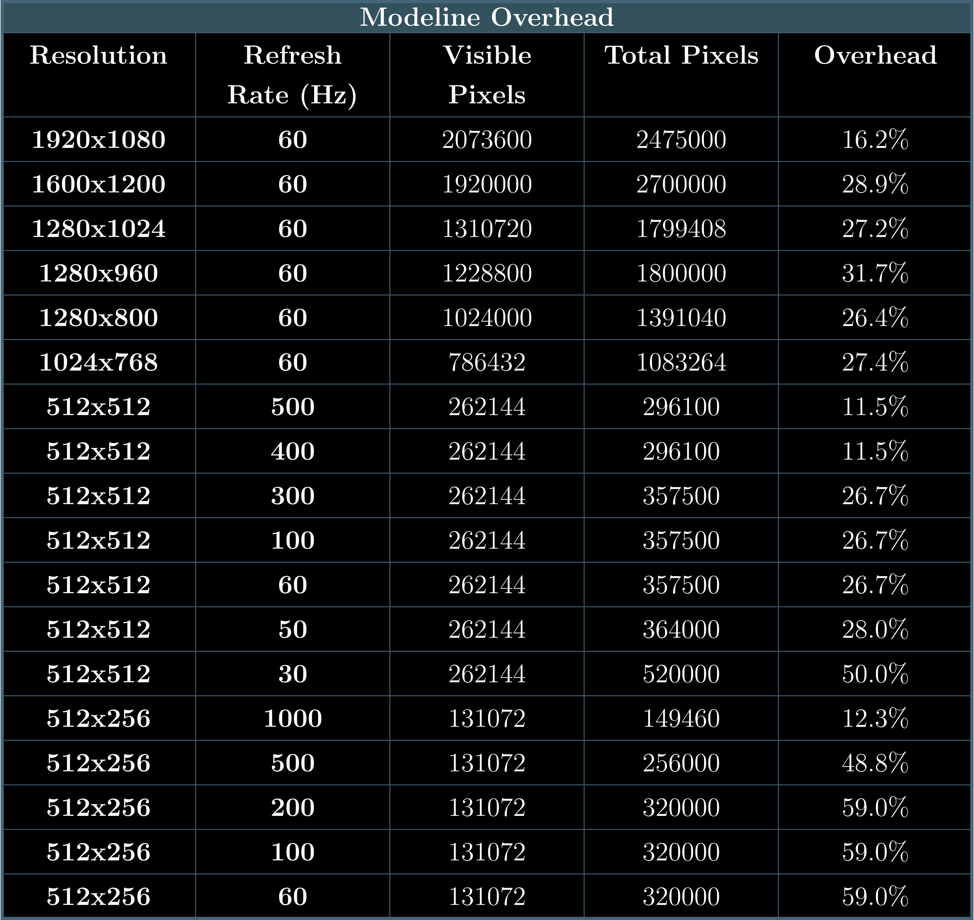
Modeline Overhead
512x512 and 512x256 are typical projector system resolutions
Not supported by VESA standard
Does not work with all hardware
Huge for Visible Pixels vs Total Pixels
Lowering resolution increases overhead
Increasing speed with custom resolutions decreases overhead.

Slide 31
Display Port Framing
Legend
Blanking Start/End
Referred to as “packetization”
Set Types of Framing Symbols
MSA contains
Total horizontal Pixels
Total Lines
Hsync/vsync information
Stuffing symbols used to space out data
Embeds formatting information into a frame.
Main Stream Attribute
Pixel Data
Filling Start/End
Frame 0
Frame 1
B
S
MSA
B
E
P
D
FS
…
FE
P
D
FS
…
FE
P
D
FS
…
FE
B
S
MSA
B
E
P
D
F S
…
FE
…

Slide 32
PDP Packets
WORD sized (fixed-length decode)
Depends on the medium
24-bit Over HDMI
Type ID
Packet type
Type specific fields
Draw Region
Draws a region to the array
Array Reset
Discharges the arrays pixels
Name | Type ID | Type Specific Fields
No Operation | 0x0
Draw Region | 0x1 | X start | X End | Y Start | Y End | Data…
Array Reset | 0x2 | Quad

Slide 33
Example Stream
Time
Stream
PDP State
Buffer
1
XS
XE
YS
YE
D
D
D
D
D
D
D
D
D
…
XS
XE
YS
YE
D
D
D
D
D
D
D
D
D
…
DR
XE
YS
YE
D
D
D
D
D
D
D
D
D
…
DR XS
YS
YE
D
D
D
D
D
D
D
D
D
…
DR XS XE
YE
D
D
D
D
D
D
D
D
D
…
DR XS XE YS
D
D
D
D
D
D
D
D
D
…
DR XS XE YS YE
D
D
D
D
D
D
D
D
…
DR XS XE YS YE
D0
D
D
D
D
D
D
D
…
DR XS XE YS YE
D0 D1
D
D
D
D
D
D
…
DR XS XE YS YE
D0 D1 D2
D
D
D
D
D
…
DR XS XE YS YE
D0 D1 D2 D3
Display
D
D
D
D
…
DR XS XE YS YE
D4
+n

Slide 34
PDP Maximum Packet Overhead
PDP Maximum Packet Overhead
Modeline |  | Bit-packed (13.5% Overhead) |  | Unpacked (7.2% Overhead)
Resolution | Framerate (Hz) | Total Pixels | Overhead Reduction (%) | Total Pixels | Overhead Reduction (%)
1920x1080 | 60 | 2397600 | 2.7 | 2235600 | 9.0
1600x1200 | 60 | 222000 | 15.4 | 2070000 | 21.7
1280x1024 | 60 | 1515520 | 13.7 | 1413120 | 20.0
1280x960 | 60 | 1420800 | 18.2 | 1324800 | 24.5
1280x800 | 60 | 1184000 | 12.9 | 1104000 | 19.2
1024x768 | 60 | 909312 | 13.9 | 847872 | 20.2
512x512 | 500 | 303104 | -2.0 | 282624 | 4.3
512x512 | 400 | 303104 | -2.0 | 282624 | 4.3
512x512 | 300 | 303104 | 13.2 | 282624 | 19.5
512x512 | 100 | 303104 | 13.2 | 282624 | 19.5
512x512 | 60 | 303104 | 13.2 | 282624 | 19.5
512x512 | 50 | 303104 | 14.5 | 282624 | 20.8
512x512 | 30 | 303104 | 36.5 | 282624 | 42.8
512x256 | 1000 | 151552 | -1.2 | 141312 | 5.1
512x256 | 500 | 151552 | 35.3 | 141312 | 41.6
512x256 | 200 | 151552 | 45.5 | 141312 | 51.8
512x256 | 100 | 151552 | 45.5 | 141312 | 51.8
512x256 | 60 | 151552 | 45.5 | 141312 | 51.8
Note: From the perspective of array writes unpacked data would only contain half the amount of “pixel” data compared to “packed” for the same modeline.

Slide 35
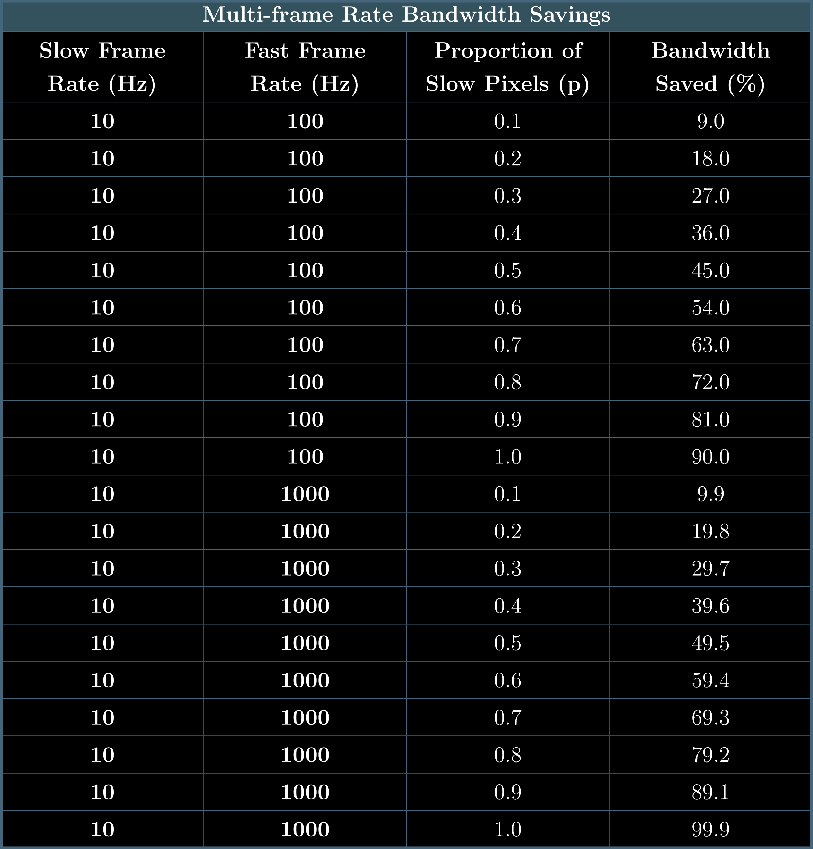
Multi-frame Rate Bandwidth Savings
Bandwidth Savings relative to operating all pixels at the fast frame rate

Slide 36
Implementation
HDMI Transport Layer / Abstract Architecture
Actual Architecture

Slide 37
HDMI Transport Layer / Abstract Architecture
Embedding Packets

Slide 38
HDMI as a PDP Transport
Normal HDMI Frame “Active Pixels”
D
D
D
D
D
D
D
D
D
D
D
D
D
D
D
D
D
D
D
D
D
D
D
D
D
D
D
D
D
D
D
D
D
D
D
D
D
D
D
D
D
D
D
…
Map each word of a PDP packet to an HDMI 24-bit pixel word.
Decode words using fixed-width Implementation
Data locations relative to packet NOT HDMI frame.
Embedded PDP Frame “Active Pixels”
1
XS
XE
YS
YE
D
D
D
D
D
1
XS
XE
YS
YE
D
D
D
D
D
D
D
D
1
XS
XE
YS
YE
D
D
D
D
D
D
D
D
D
D
1
XS
XE
YS
YE
…
Draw Region Packet
1
XS
XE
YS
YE
D
D
D
…
Type; X_Start; X_End; Y_Start; Y_End; Data…

Slide 39



Embedding PDP Packets
Large Array Emitter
Small Data Frame (not to scale)
1
High Speed
…
XS
XE
YS
YE
D
D
1
Low Speed
XS
XE
YS
YE
D
D
D
D
1
XS
XE
YS
YE
D
D
D
Low Speed
Low Speed

Slide 40
Architecture
Abstract Architecture
Components
State Machines

Slide 41
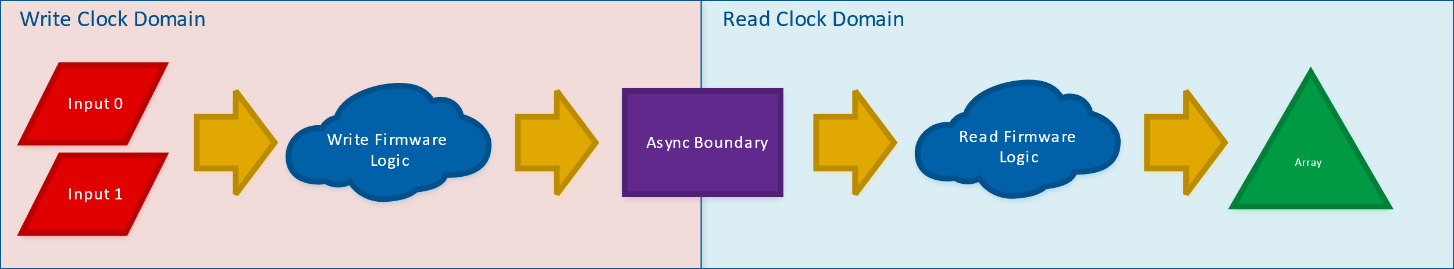
Abstract Architecture
Separate domains
Classical Consumer-Producer Paradigm
Producer
Consumer

Slide 42
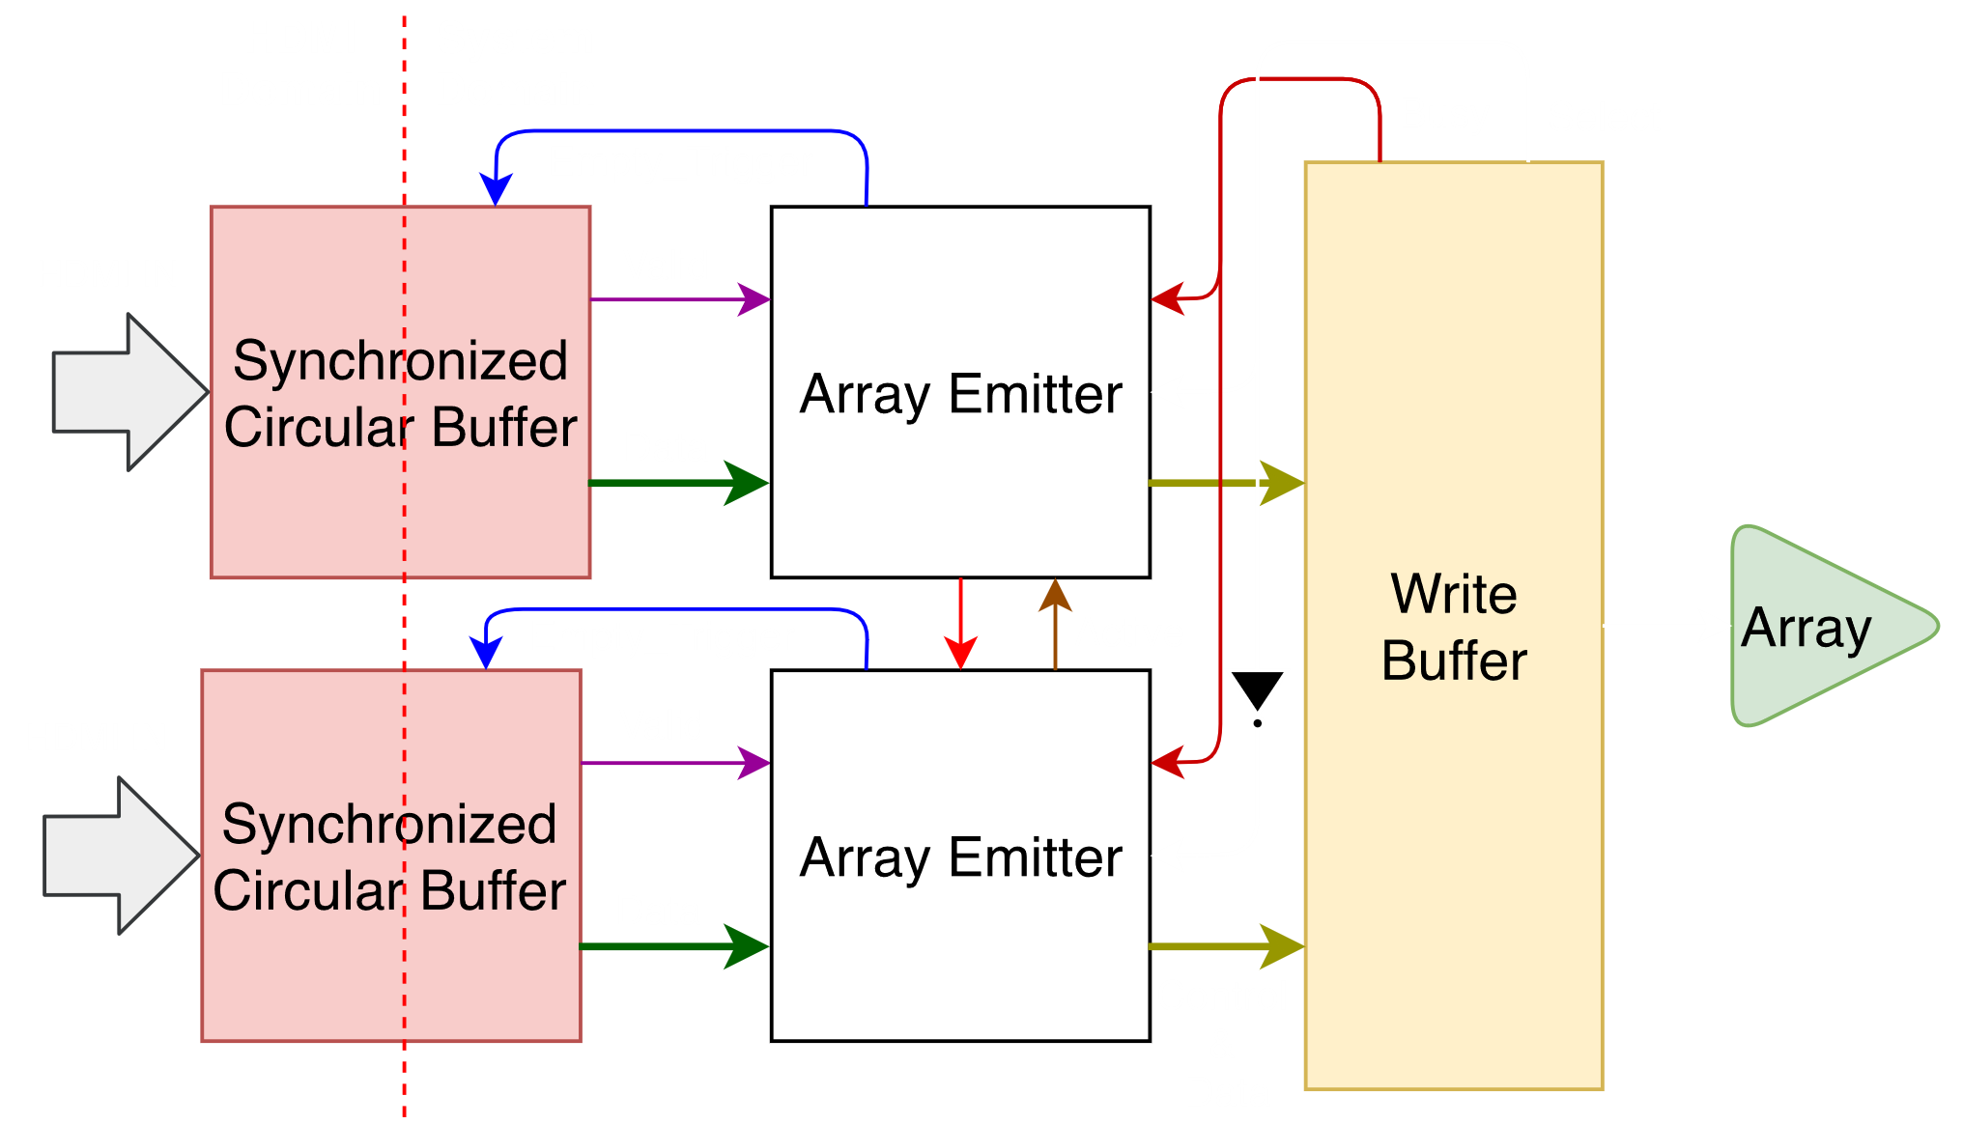
Overall Backend Architecture
HDMI Domain
Synchronized Circular Buffer Write
2 Independently Clocked Inputs
System Domain
Synchronized Circular Buffer Read
Array Emitter
Write Buffer

Slide 43
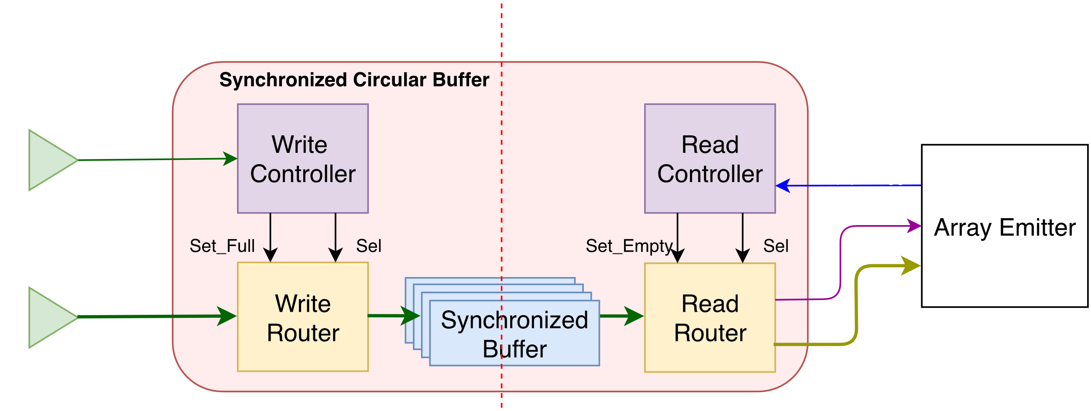
Synchronized Circular Buffer
HDMI Domain
Write Controller
Write Router
Synchronized Buffer
System Domain
Read Controller
Read Router

Slide 44
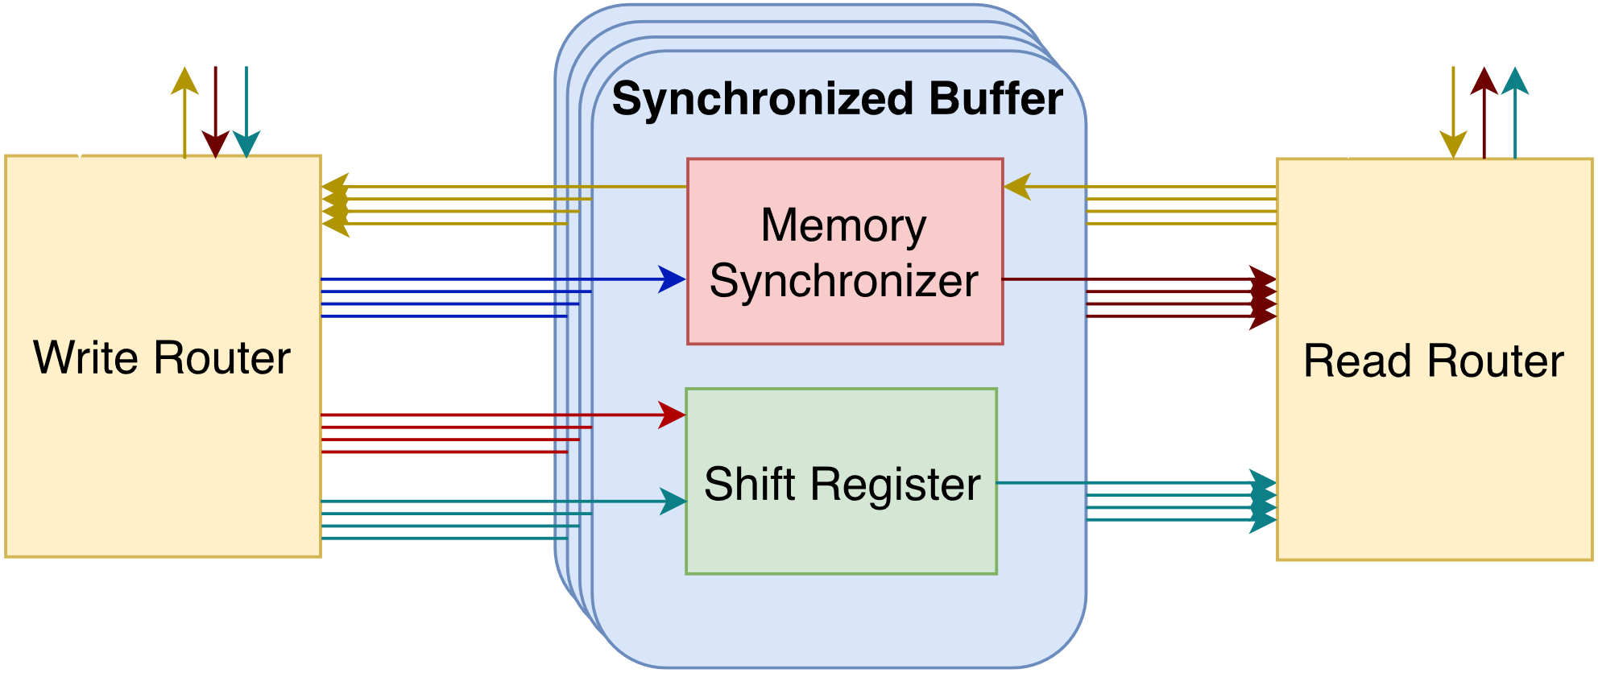
Synchronized Buffer

Slide 45
Full/Empty Synchronizer
Data storage locations are synchronized using two flags
empty_flag: when high indicates that a value has not been produced (writer clocked)
full_flag: when high indicates that a value has been produced (reader clocked)
Usage
Writer: stalls until the empty_flag is high, shifts in data, and toggles set_full
Reader: stalls until the full_flag is high, shifts out data, and toggles set_empty
Operation
Over asynchronous clock domains

Slide 46
Memory Synchronizer Logic
Write
Domain
Read
Domain
set_full
empty_flag ↓
Req ↑
Request/Acknowledgement Double Handshake Across Clock Domains
State transitions initiated via set_full and set_empty lines.
Designed so either domain can access the flags as soon as it is available
full_flag ↑
Stable
set_empty
full_flag ↓
Ack ↑
Req ↓
Ack ↓
empty_flag ↑

Slide 47
Two Flip-flop Synchronizer
Used to Synchronize a bit across domains
A third stage can be used for faster clocks
Ideal for FPGA based designs where timing changings by resynthesis
Bad Design to use combinational logic to route clocks
data
register
data
register
data
register
data
aclk
bclk
Discussed in:
Clock Domain Crossing (CDC) Design & Verification Rev 1.0 Techniques Using SystemVerilog

Slide 48
Memory Synchronizer Circuit
writer clock
ack
register
ack int
register
ack
latch
set
set empty
empty flag
reset
full flag
reset
set full
set
req
latch
req int
register
req
register
reader clock

Slide 49
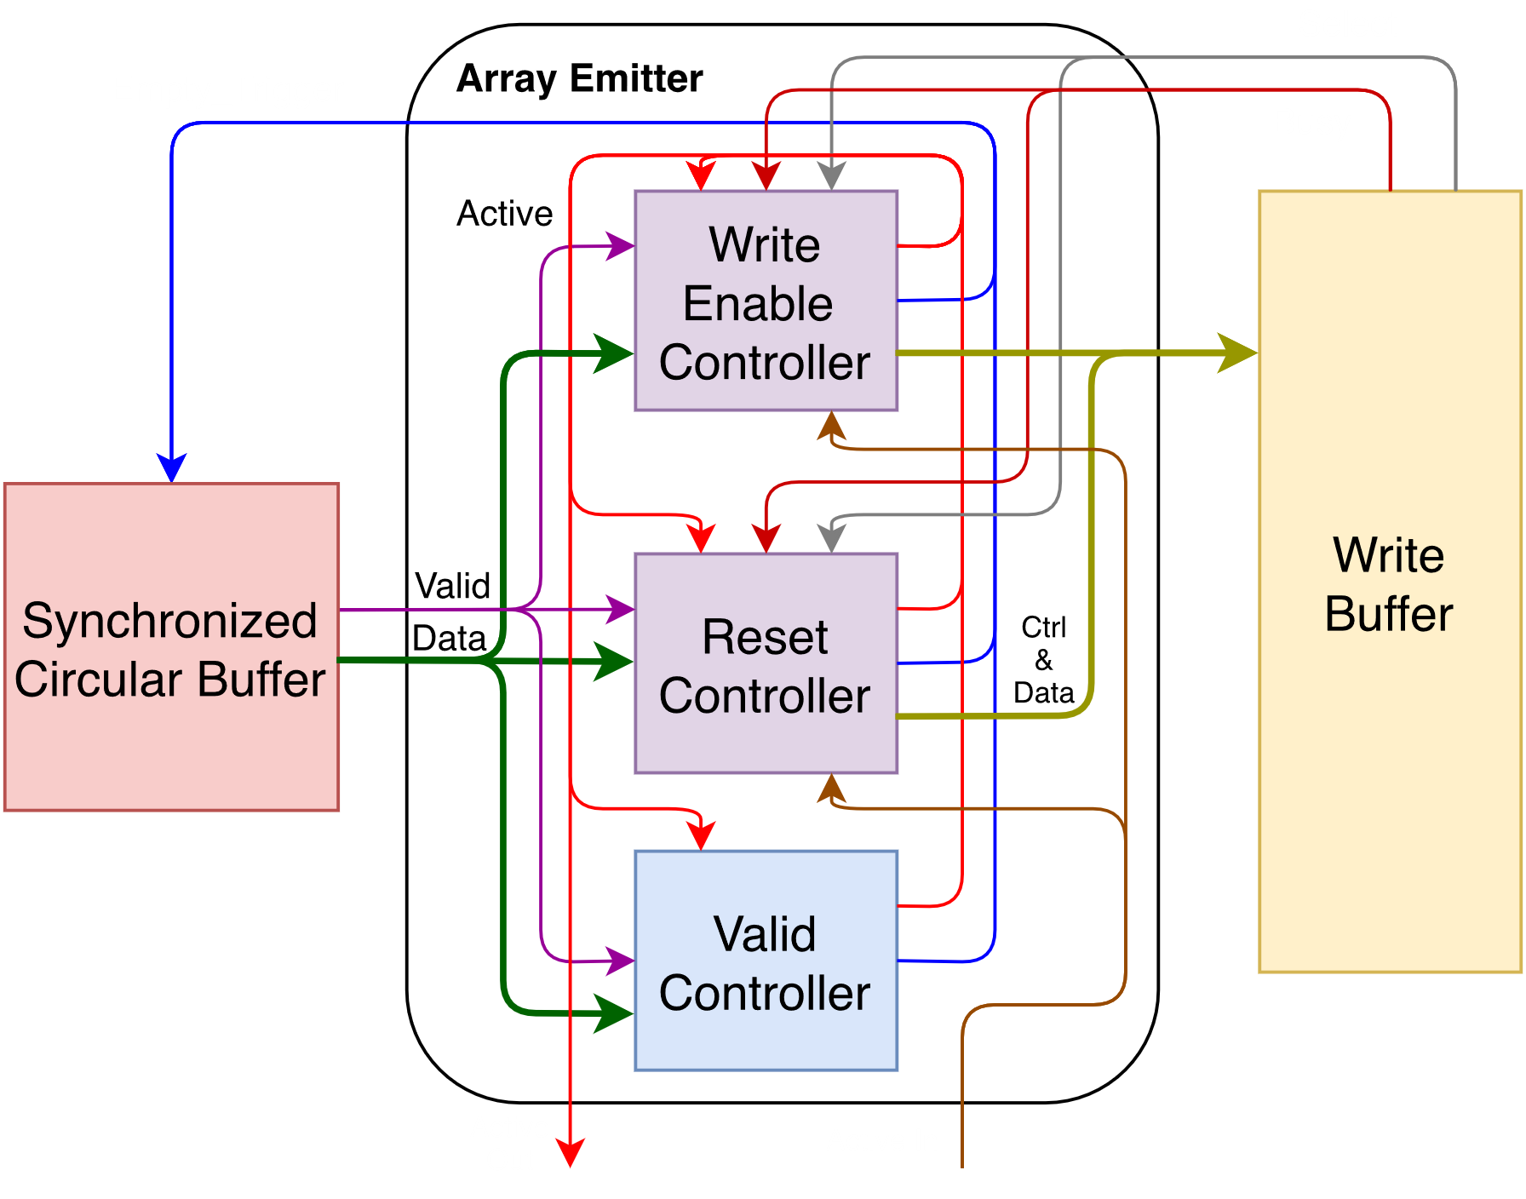
Array Emitter Logic
Each controller used to decode one packet type
Controller List
Write Enable Controller
Reset Controller
Valid Controller

Slide 50
Array Emitter State Machines
Data Signals
1
XS
XE
YS
YE
D
D
D
…
Array Emitter State Machines
Read 24-bit word and decode
State Machines
Write Enable Controller → Draw Region State Machine
Reset Controller → Array Reset State Machine
Valid Controller → Not shown
Read Command From Data Stream
Draw Region Array Reset
Load Reg
X_end
Load Reg
X_start
Write Load=0
Load Reg
X_start
Load Reg
Y_end
Write Load=1
Write Data
Load Pixel Data

Slide 51
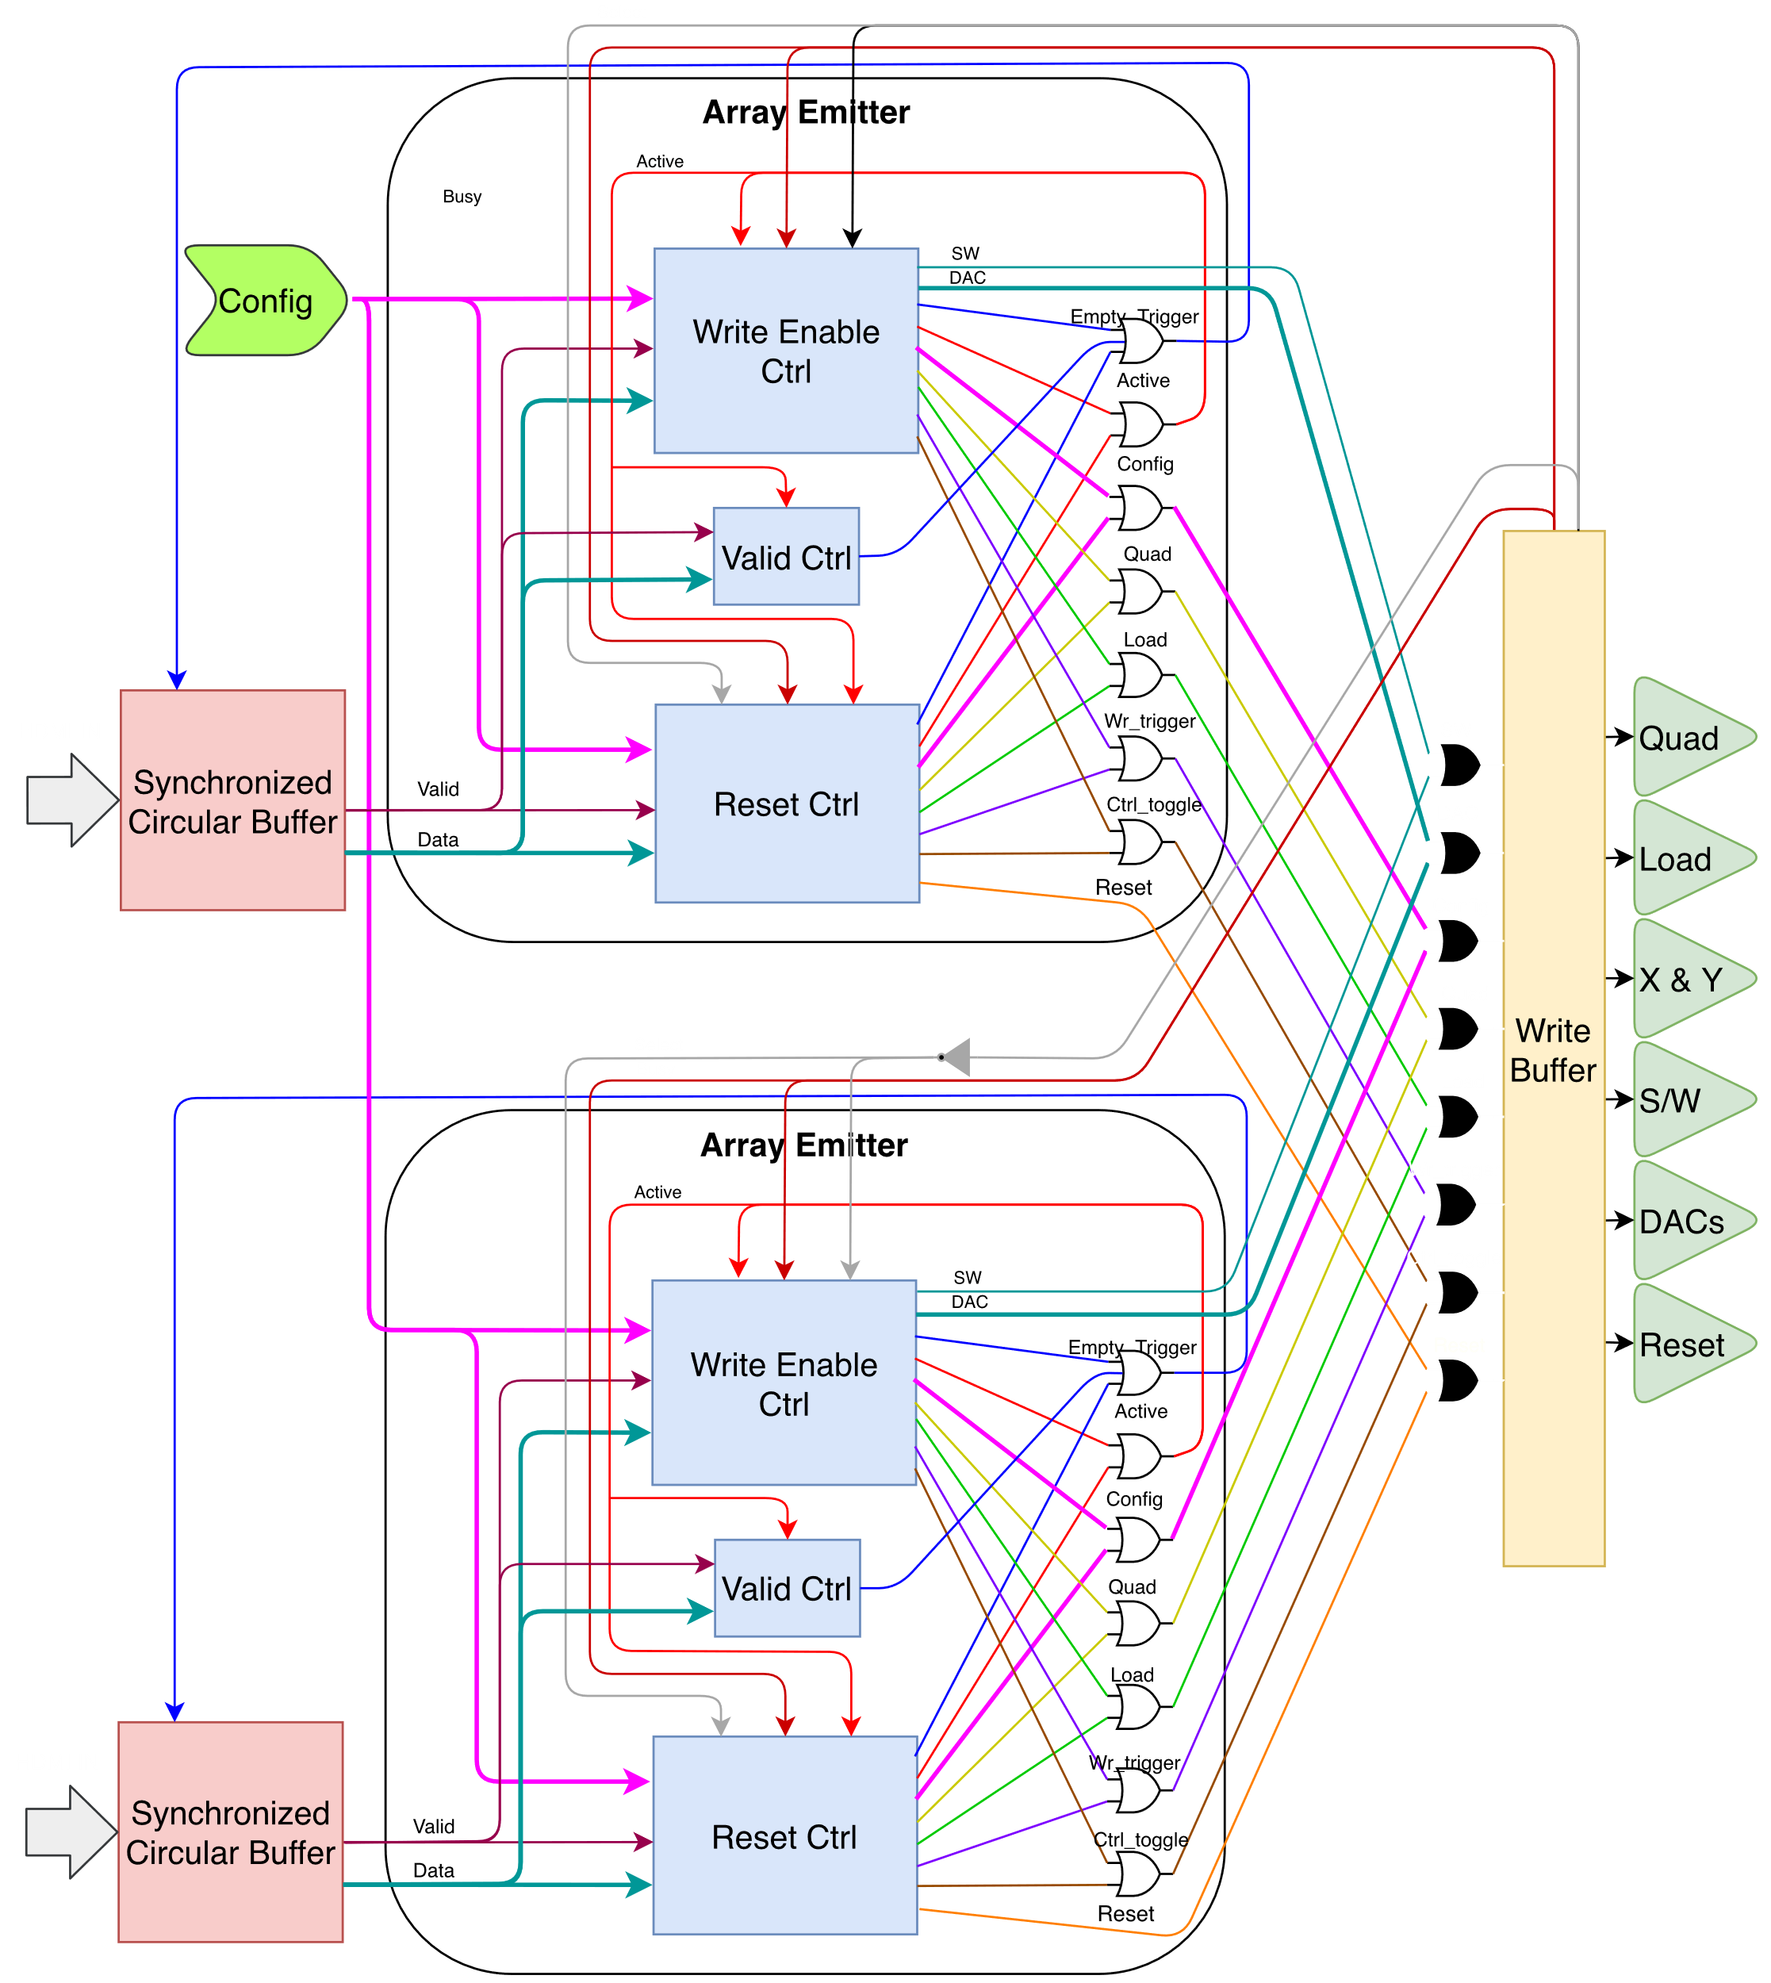
Write Buffer
Writes to an array
Inputs Muxed
Length of time per write/reset configurable
Switches between two array emitters.

Slide 52
Experimental Results
Memory Synchronizer Testing
Firmware Characterization
High-speed & Multi-frame Rate Testing

Slide 53
Memory Synchronizer Testing
Simulations
Experimental Testing

Slide 54
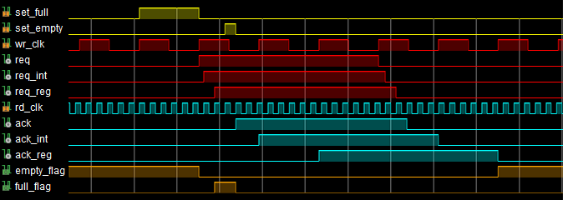
Behavioral Simulation of a Single Pixel Being Buffered Through the Full/Empty Memory Synchronizer
Writer
Reader
Req.
Ack.

Slide 55
Setup of Synchronizer Experiments
Hardware
ZYBO Test Board (Zync 7010 AP SOC)
Intel(R) Core(TM) i7-6700 CPU @ 3.40GHz
Nvidia M4000
Video Capture Card
Serial Ports (UART)
VGA
HDMI
Firmware (HDL)
Synchronized Circular Buffer
UART RX/TX Implementation
Command Logic
Data Verification Circuit
Software (Python)
Based Image Driver
Command Logic
VGA Loop-back
Test PC
ZYBO
HDMI
UART TX/RX

Slide 56


Synchronizer Experiments
Visual Test
Send Checkerboard Image through HDMI
Loop-back to Capture Card
Inspect Image
Integrity Test
Send random CRC-like patterns
Use verification circuit to compare
Use UART To pull statistical information and error counts.
Checkboard Image
CRC-like Random
Image
R0
R1
R2
R3
R4
R5
R6
R7
R0
R1
R2
R3
R4
R5
R6
R7
CRC-like 16-pixel Stream

Slide 57
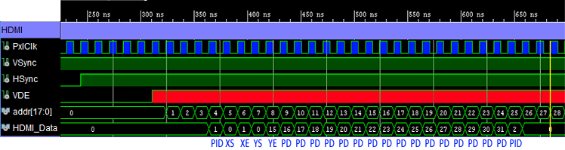
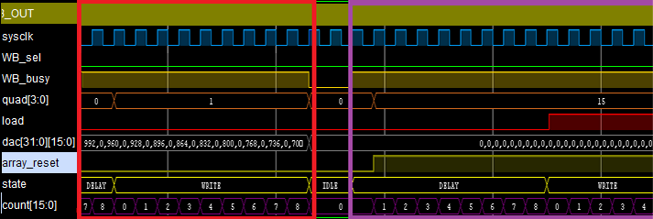
Simulations of Overall PDP Firmware
HDMI IN
HDMI Input: Draw Region Packet
Array Write: From Draw Region Packet
Array Reset: From Reset Packet
Write Buffer

Slide 58
Firmware Characterization
Performed in Backwards Compatibility Mode
New PDP Firmware Vs. Old Firmware
Analog Bandwidth

Slide 59


Grid maps
Example Input Pattern
Grid with set spacing, X or Y offset each frame
Put images together & Produce Array Map
Example Array Output

Slide 60
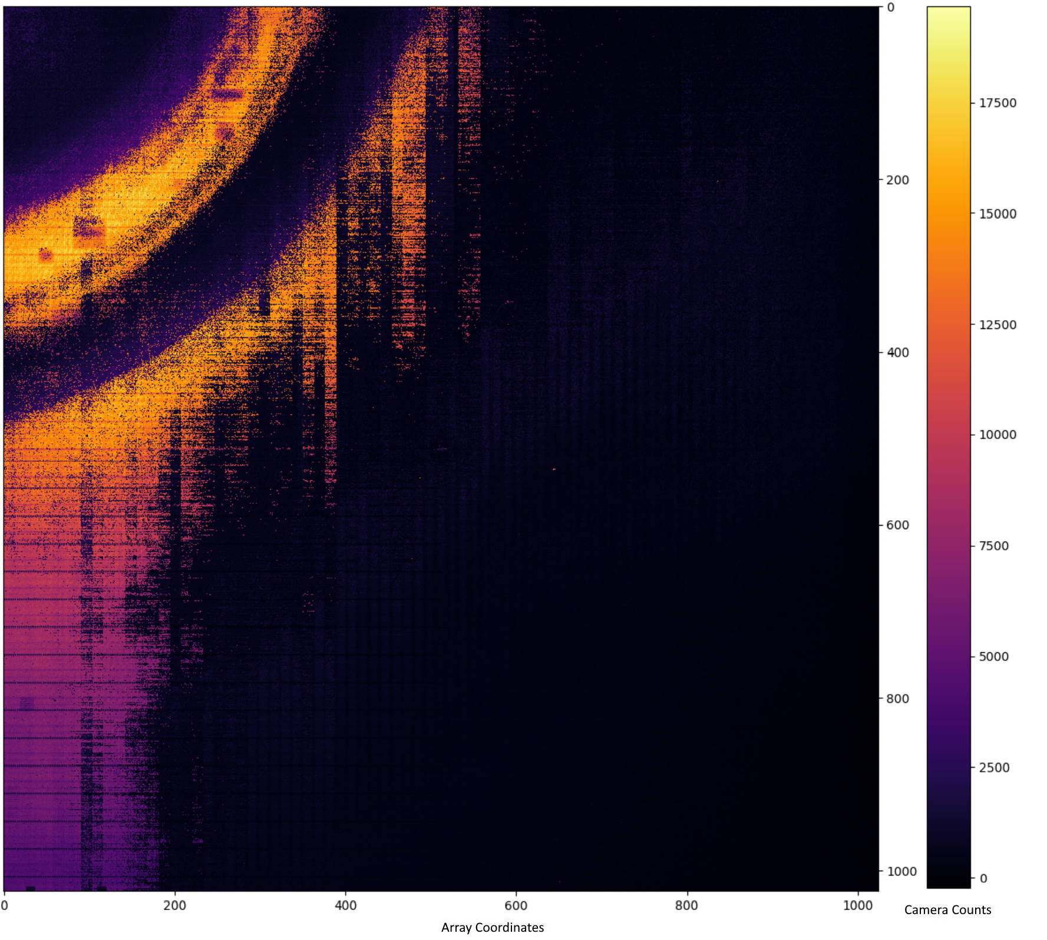

Array Maps
PDP
SNAP

Slide 61
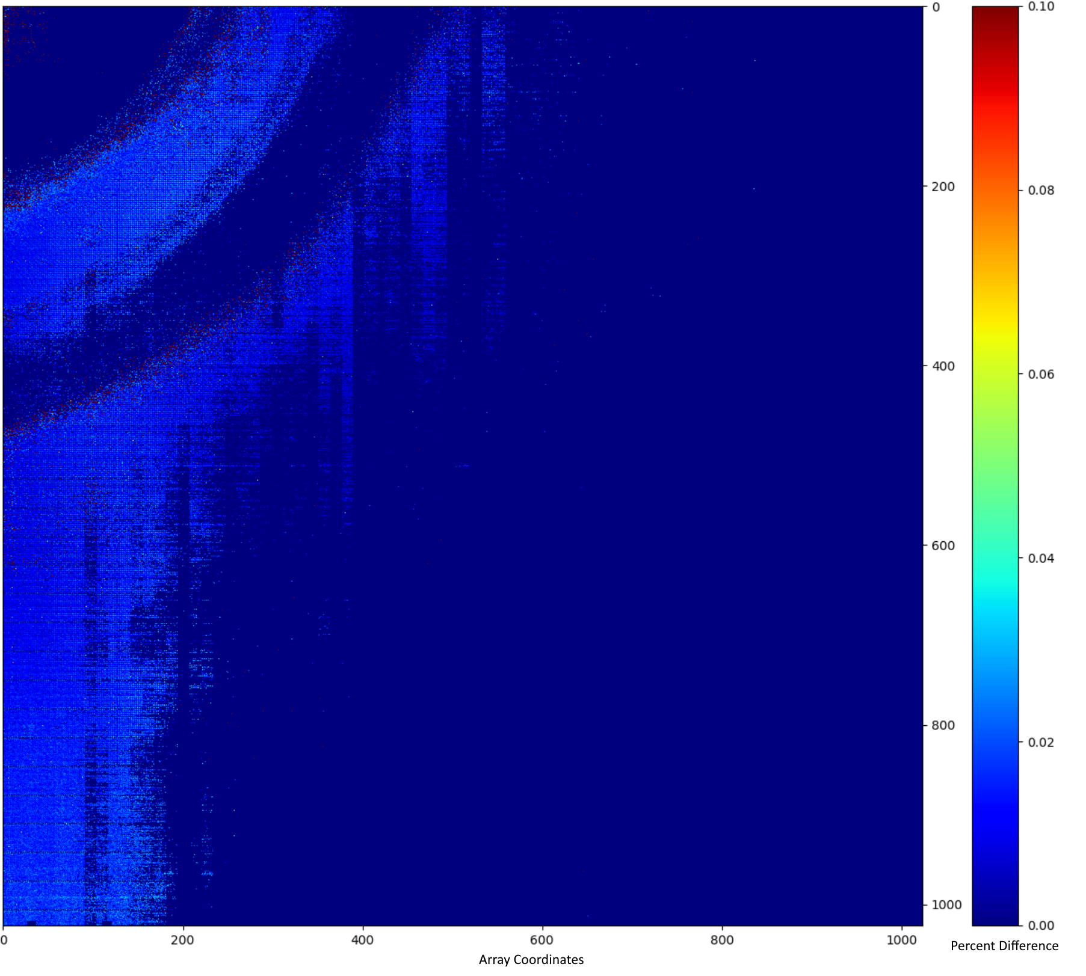
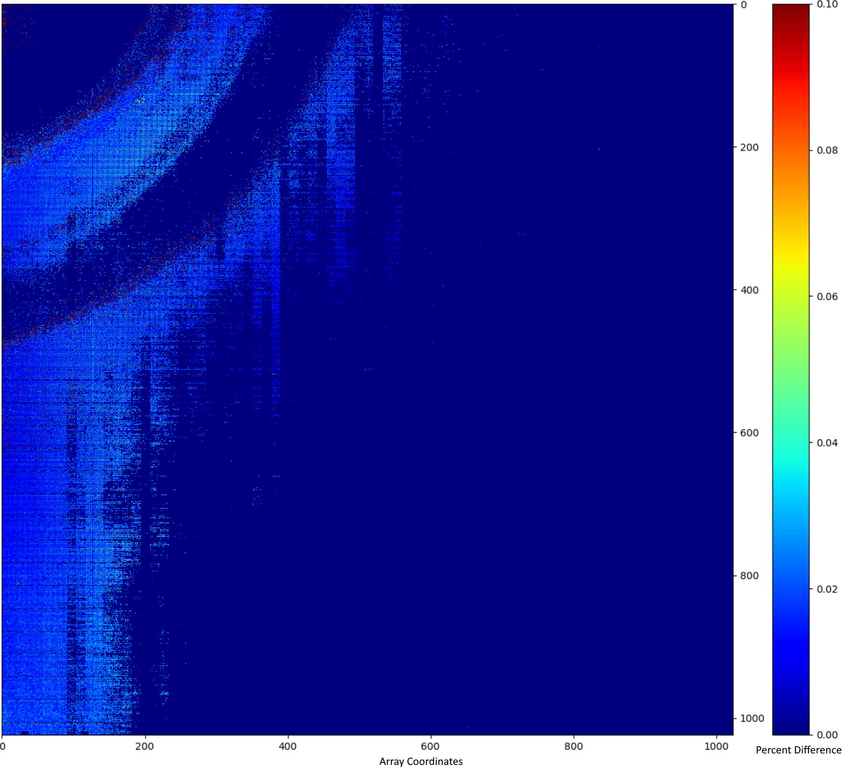
Fractional Difference Map
PDP
SNAP

Slide 62


Non-uniformity Corrected Image
IR
Original

Slide 63
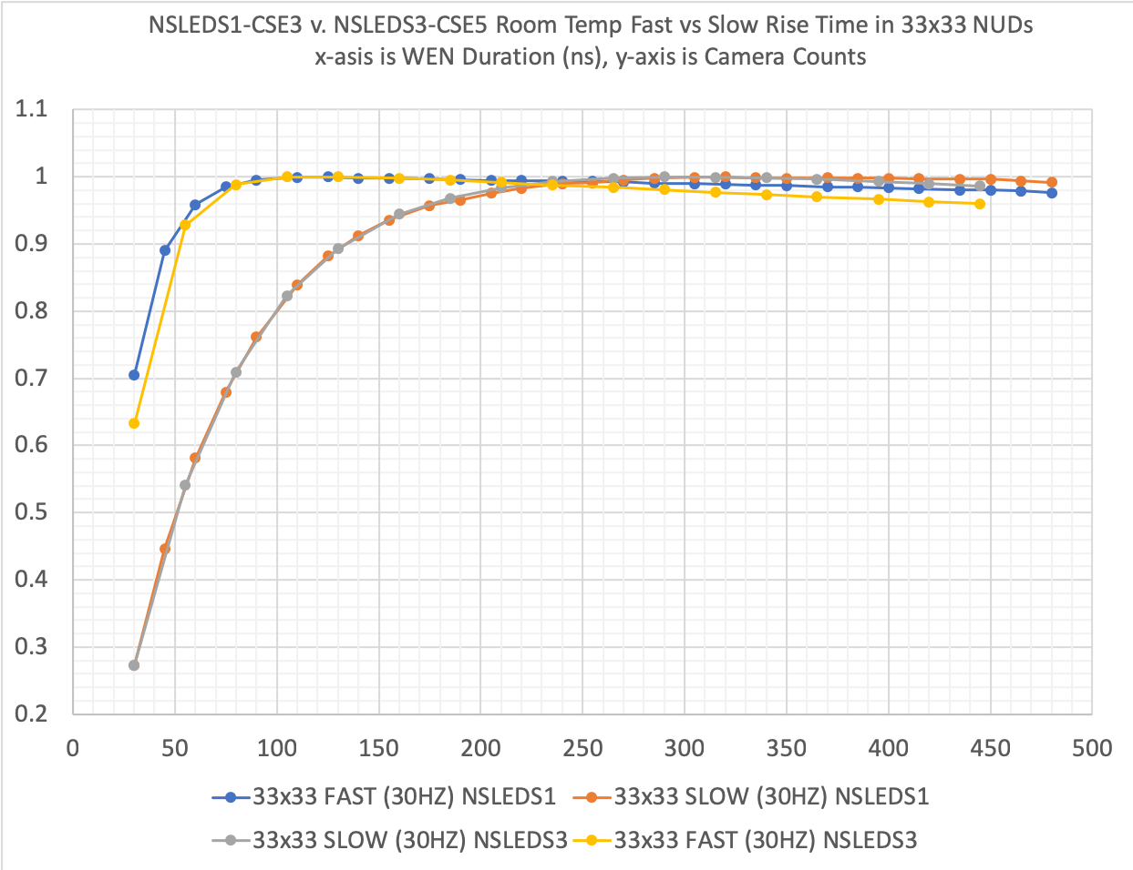
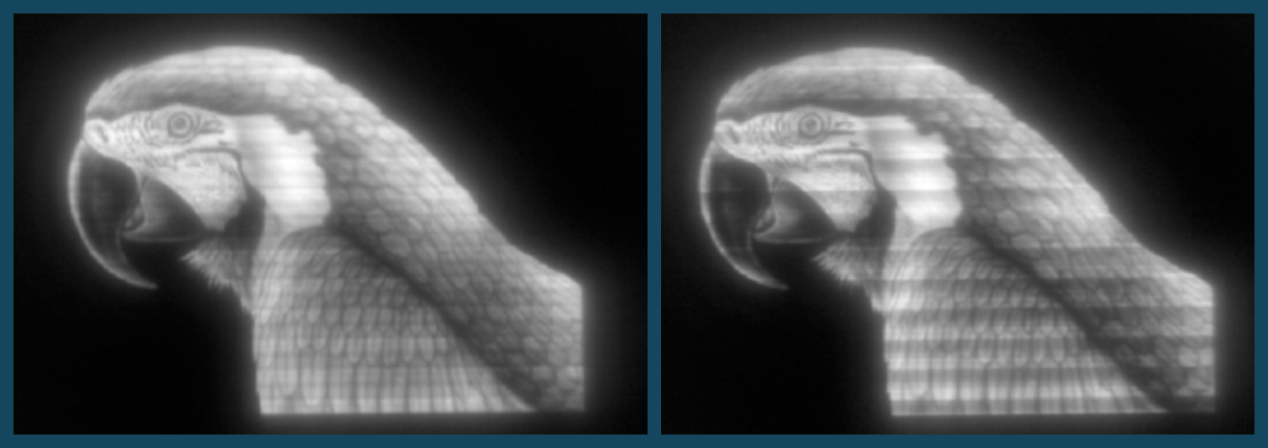
Analog Bandwidth
Rise Time
100hz
400hz

Slide 64
High-speed & Multi-frame Rate Testing
Performed in PDP Mode
Select Experiments

Slide 65
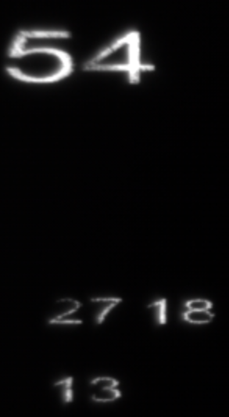
Low-speed Packetized Operation
Series of numbers operating at low speed
Demo ran from 60hz to 240hz
Used for initial verification of packetized mode of operation.
Each digit was drawn using a draw region packet

Slide 66
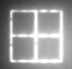
One Kilohertz Operation
Moving object that bounced around the array.
Drawn using a Single Draw Region Packet.
Recorded using an IR Camera in “Windowed” Mode.
Not Possible outside of “PDP” mode of operation on the same hardware.

Slide 67
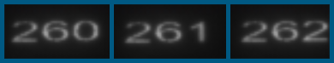
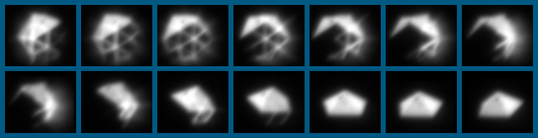
Two Kilohertz Operation
Counting numbers
Static + Bouncing Configurations
Increments by 1 for each frame
Each digit is a separate packet.
Non-uniformity Corrected Rotating 3-dimensional Object
Maintains image fidelity
compare to 400hz bird image.
Each rotation drawn using a separate packet.

Slide 68
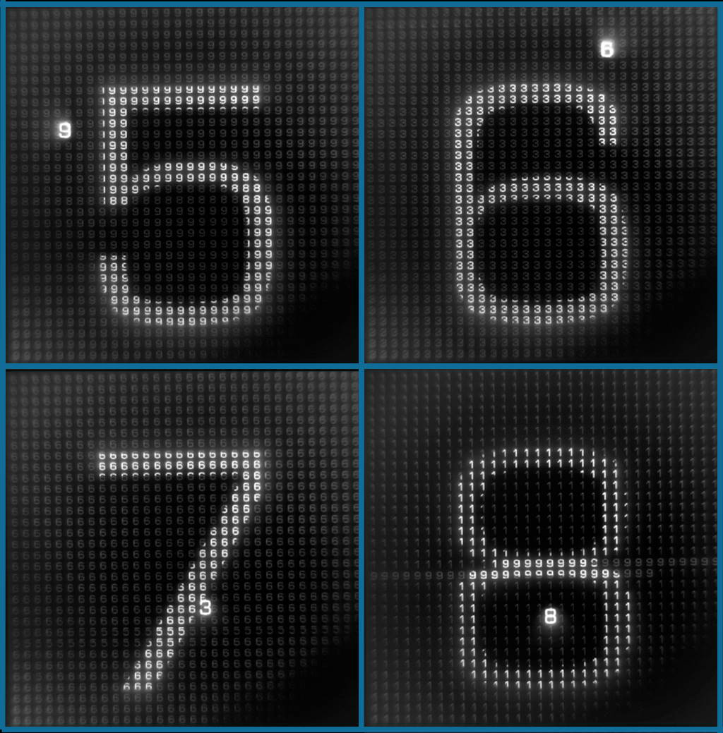
Multi-frame Rate Operation
Rates:
800hz: Bouncing Small Number
100hz: Small Background Numbers
2Hz: Large Number
Each Number drawn using a packet.

Slide 69
Conclusion
Contributions
Architected a physical layer agnostic packetized display protocol
Architected prototype firmware that demonstrated
backwards compatibility with existing protocols
dynamic bandwidth utilization
high-speed operation (2Kz, etc.)
Demonstrated multiple Frame-rate Operation
Used in day-to-day operations of a real system
Future Work
Support and improve upon the technology.
Push to see adoption within the IRSP field.
Dynamic Frame segmentation.

Slide 70

Done

Slide 71
Backup

Slide 72
Established IRSP technology
Resistor arrays (black-body emitters)
Advantages
Well established
Stable
Spectrally accurate
Disadvantages
Limited maximum temperature (~800K)
Limited potential to scale beyond 48µm and therefore resolutions above 1024x1024
Limited maximum speed due to cool-down
Can be easily damaged with poorly controlled scenery
Must be optically combined to produce separately controlled wavelengths
Optical rise time of few milliseconds

Slide 73
Super-Lattice Light-Emitting-Diode (SLED) based IRSP
Very high apparent temperature (1400K+)
High density (24µm now, 12µm or smaller in the future)
Inherently Fast, limited primarily by the electronics
Relatively difficult to damage thermally
Multi-color pixels possible
Optical rise time in nanoseconds

Slide 74
CSE External Indirect API Communication Block Diagram
Scene Generator
CSE
Client
Comm
CSE Operations Box
Serial
Comm
CSE Operation
APIs
Signaling
Array
Scene Data
Scene Generation
LPC FMC
Scene Data
LPC FMC
DVI|HDMI|DP|ARNIC 818
Fiber (in development)

Slide 75
CSE External Indirect API and Data Communication Block Diagram
Scene Generator
CSE
Client
Comm
CSE Operations Box
Serial
Comm
CSE Operation
APIs
Signaling
Array
Scene Data
Scene Data
Scene Generation
LPC FMC
Scene Data
Scene Data
LPC FMC
DVI|HDMI|DP|ARNIC 818
Fiber (in development)
Pre-formatted

Slide 76
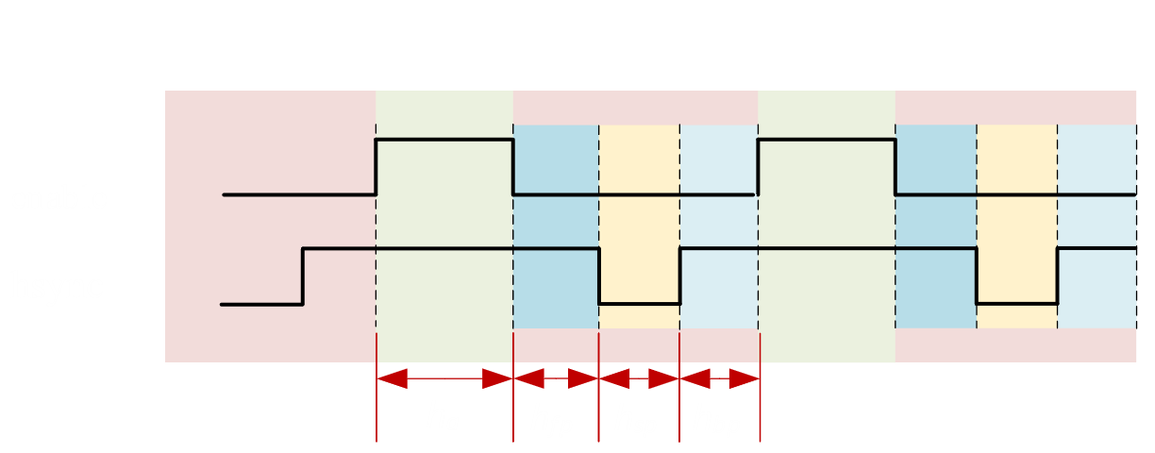
Horizontal Cross Section Timing

Slide 77
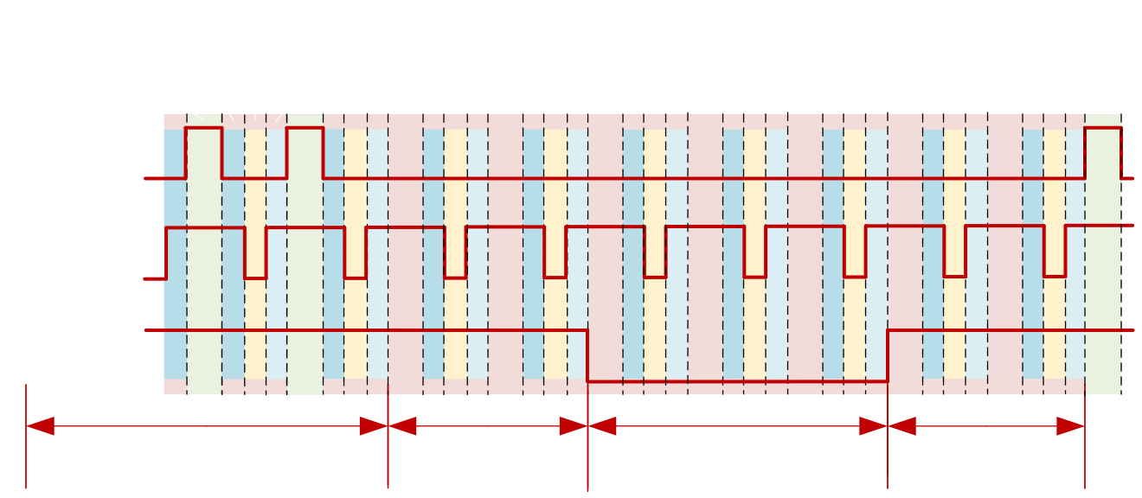
Full Cross Section Timing

Slide 78

Formulas

Slide 79




PDP Overhead
Total Pixel Overhead
Packet Overhead
Maximum Packet Count
Resolution
Minimum Packet Size
Draw Region Packet size
Minimum Region Write Size
(bit-packed)
Minimum Region Write Size
(unpacked)
Total Pixel Count with Overhead

Slide 80




PDP Overhead Percentage
Total Overhead Percentage
Total Pixel Overhead
Total Pixel Count with Overhead
Overhead (bit-packed)
Overhead (unpacked)

Slide 81
Frontend Architecture
Communication
APIs

Slide 82
C Implementation
Command Based Two-sided Communication between Frontend PC and Frontend Firmware
Used to control the firmware settings and mode of operation
Twiddles Memory Mapped Registers
SuperFPGA
Interface Board
Interface Board
NUCPC
Frontend
Firmware /
MicroBlaze
Controller
Master
Microcontroller
Slave
Microcontroller
Backend
Firmware /
FPGA
LCD

Slide 83

Select Frontend APIs
Remote RPC Layer (zerorpc)
Callable APIs

Slide 84
Full/Empty Memory Synchronizer State Transitions
Signal | ←Stable → |  |  | S e t | Wr Domain → Rd Domain |  |  | ←Stable→ |  |  | S e t | Rd Domain → Wr Domain |  |  |  | Wr Domain → Rd Domain |  |  |  | Rd Domain → Wr Domain |  |  | ←Stable→
set_full | 0 | … | 0 | 1 | 0 | … | 0 | 0 | … | 0 | 0 | 0 | … | 0 | 0 | 0 | … | 0 | 0 | 0 | … | 0 | 0 | … | 0
set_empty | 0 | … | 0 | 0 | 0 | … | 0 | 0 | … | 0 | 1 | 0 | … | 0 | 0 | 0 | … | 0 | 0 | 0 | … | 0 | 0 | … | 0
req latch | 0 | … | 0 | 0 | 1 | … | 1 | 1 | … | 1 | 1 | 1 | … | 1 | 1 | 0 | … | 0 | 0 | 0 | … | 0 | 0 | … | 0
req int reg | 0 | … | 0 | 0 | 0 | … | 1 | 1 | … | 1 | 1 | 1 | … | 1 | 1 | 1 | … | 0 | 0 | 0 | … | 0 | 0 | … | 0
req reg | 0 | … | 0 | 0 | 0 | … | 0 | 1 | … | 1 | 1 | 1 | … | 1 | 1 | 1 | … | 1 | 0 | 0 | … | 0 | 0 | … | 0
ack latch | 0 | … | 0 | 0 | 0 | … | 0 | 0 | … | 0 | 0 | 1 | … | 1 | 1 | 1 | … | 1 | 1 | 0 | … | 0 | 0 | … | 0
ack int reg | 0 | … | 0 | 0 | 0 | … | 0 | 0 | … | 0 | 0 | 0 | … | 1 | 1 | 1 | … | 1 | 1 | 1 | … | 0 | 0 | … | 0
ack reg | 0 | … | 0 | 0 | 0 | … | 0 | 0 | … | 0 | 0 | 0 | … | 0 | 1 | 1 |  | 1 | 1 | 1 | … | 1 | 0 | … | 0
empty flag | 1 | … | 1 | 1 | 0 | … | 0 | 0 | … | 0 | 0 | 0 | … | 0 | 0 | 0 | … | 0 | 0 | 0 | … | 0 | 1 | … | 1
full flag | 0 | … | 0 | 0 | 0 | … | 0 | 1 | … | 1 | 1 | 0 | … | 0 | 0 | 0 | … | 0 | 0 | 0 | … | 0 | 0 | … | 0

Slide 85
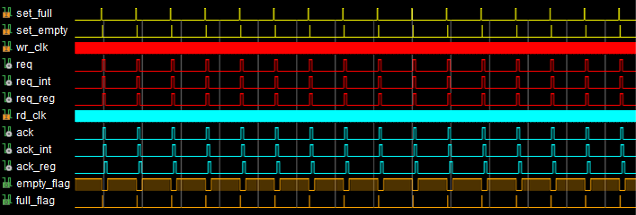
Behavioral Simulation of Multiple Pixels Being Buffered Through the Full/Empty Memory Synchronizer
Writer
Reader
Req.
Ack.

Slide 86
Array Write Process
Array Layout
Pixel Layout
Array Write Process
Data Processing & Ordering

Slide 87
TCSA, NSLEDS, and HDILED Array Quadrant Layouts
TCSA
NSLEDS
HDILED
Q1
Q2
Q1
Q2
Q1
Q2
256
512
1024
512
1024
2048
Q3
Q4
Q3
Q4
Q3
Q4
256
512
1024
512
1024
2048

Slide 88
NSLEDS/HDILED Array Super Pixel Layout
Super Pixels
Tiled Super Pixels
Columns
Shared Drive Strength
0 1 2 3 4 5 6 7
0
1
2
3
4
5
6
7
…
…
…
…
…
…
…
…
p|ch1
n|ch0
LOAD=0
p|ch1
n|ch0
Rows
LOAD=1
…
…
…
…
…
…
…
…
Shared Drive Strength

Slide 89
Interleaved Array Write Process
Buffer 32 pixels worth of data.

Slide 90
Bit-packing Format
RGB Legend
R: Red G: Green B: Blue
“Pixels” are clipped and scaled into an 11-bit format packeted into a 24-bit RGB pixel word.
Segmented by column
Even columns go into the L portions.
Odd Columns go into the R portions.
For example:
Pixels of column 0 and 1 would combine into a single 22-bit RGB pixel (with one strong bit).
Pixels of Column 2 and 3 would combine similarly, so on so forth
Mapping Legend
S: Drive Strength L: Left R: Right U: Unused
Pixel Data Bit-packing
Bit | 23 | 22 | 21 | 20 | 19 | 18 | 17 | 16 | 15 | 14 | 13 | 12 | 11 | 10 | 9 | 8 | 7 | 6 | 5 | 4 | 3 | 2 | 1 | 0
RGB | R | R | R | R | R | R | R | R | G | G | G | G | G | G | G | G | B | B | B | B | B | B | B | B
Mapping | S | L | L | L | L | L | L | L | L | L | L | L | U | R | R | R | R | R | R | R | R | R | R | R
1
11
11

Slide 91




Image Processing
CSE Input 1
Original or NUC Image
Bit-pack
Even/Odd Row Reorder
Transpose
Array
*
CSE Input 2
*Not Accurate Out, For Explanation Only

Slide 92
Quadrant Layout
Q1
Q2
Q1
Q2
Q1
Q2
Q1
Q2
Q1
Q2
*
Q3
Q4
Q3
Q4
Q3
Q4
Q3
Q4
Q3
Q4
*Not Accurate Out, For Explanation Only

Slide 93
Quadrant Layout Colored
Q1
Q2
*
Original or NUC Image
Bit-pack
Q1
Q2
Q1
Q1
Q2
Q1
Q2
Even/Odd
Row Reorder
Transpose
Array
Q2
Q3
Q4
Q3
Q4
Q3
Q4
Q3
Q3
Q4
Q4
*Not Accurate Out, For Explanation Only

Slide 94






Bit-packing
Clip & scale pixels down to 11 bits each, pack two 11-bit pixels into one 24-bit pixel.
Original or NUC Image
Bit-pack
Even/Odd Row Reorder
Transpose
Array
*
0 1 2 3 4 5
0 1 2
*Not Accurate Out, For Explanation Only

Slide 95






Data Reordering
16 even, 16 odd, 16 even, 16 odd…
0
0
31
31
32
32
Original or NUC Image
Bit-pack
Transpose
Array
*
Even/Odd
Row Reorder
63
63
1024
1024
512
512
512
1024
*Not Accurate Out, For Explanation Only

Slide 96




Example 1
CSE Input 1
*
Original or NUC Image
Bit-pack
Even/Odd Row Reorder
Transpose
Array
CSE Input 2
*Not Accurate Out, For Explanation Only

Slide 97




Example 2
CSE Input 1
*
Original or NUC Image
Bit-pack
Even/Odd
Row Reorder
Transpose
Array
CSE Input 2
*Not Accurate Out, For Explanation Only

Slide 98




Example 3
CSE Input 1
*
Original or NUC Image
Bit-pack
Even/Odd Row Reorder
\
Transpose
Array
CSE Input 2
*Not Accurate Out, For Explanation Only

Slide 99
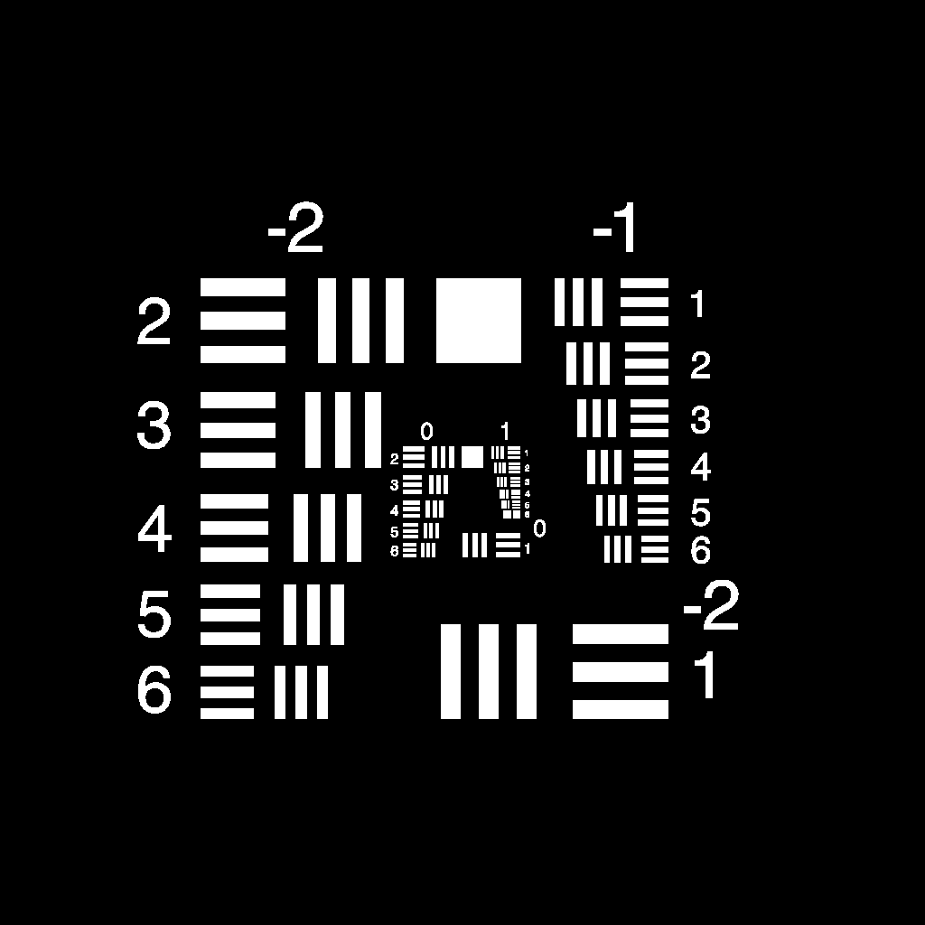


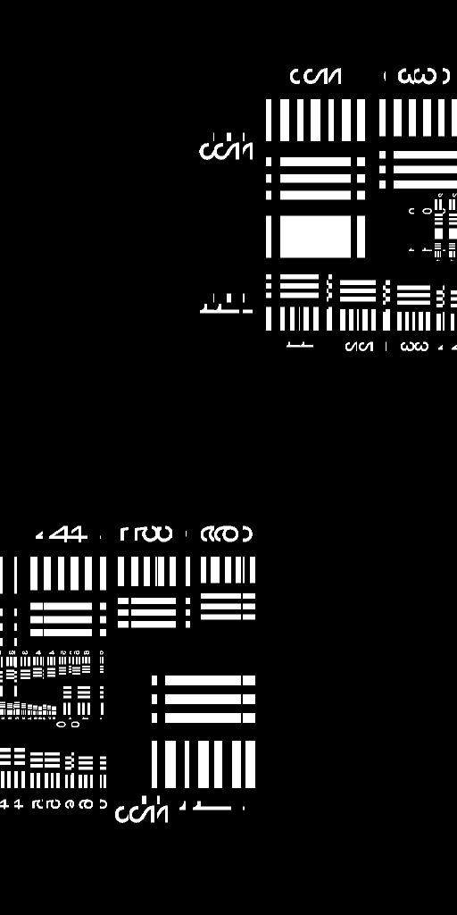
Example IR
CSE Input 1
Original or NUC Image
Bit-pack
Even/Odd Row Reorder
Transpose
Array
CSE Input 2

Slide 100




Example IR 2
CSE Input 1
Original or NUC Image
Bit-pack
Even/Odd Row Reorder
Transpose
Array
CSE Input 2

Slide 101
Machine Model
Abstract Machine Model
Compositing Example

Slide 102
Hardware Mapping of an IRLED Projection Process
Sc. Gen. Hardware
NUC Hardware
CSE
Array
Scene-Generation
Non-Uniformity Correction / Reordering
Digital to Analog Conversion
Projection
Sc. Gen. Hardware
CSE
Array
Scene-Generation
Non-Uniformity Correction / Reordering
Digital to Analog Conversion
Projection

Slide 103
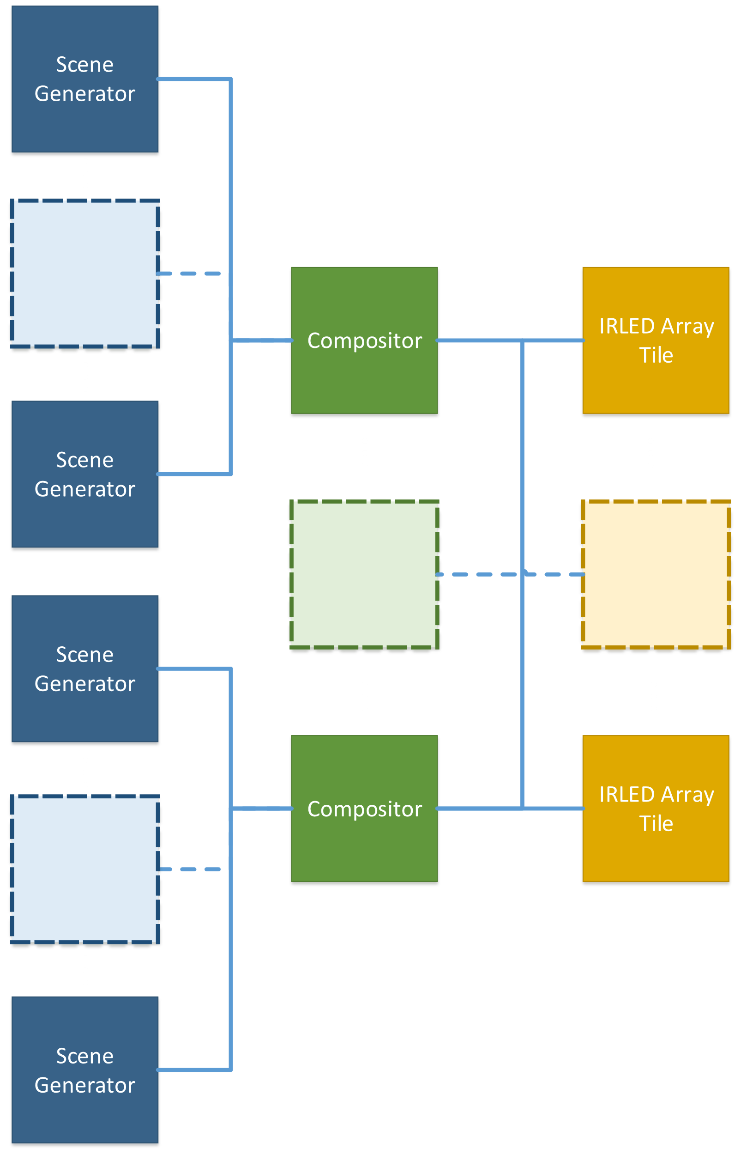
Abstract Machine Model
Component breakdown:
1 to N Scene Generators
1 to M Compositors
1 to P Projector Tiles
Benefits
Scalability
Distributed
Generalizable

Slide 104
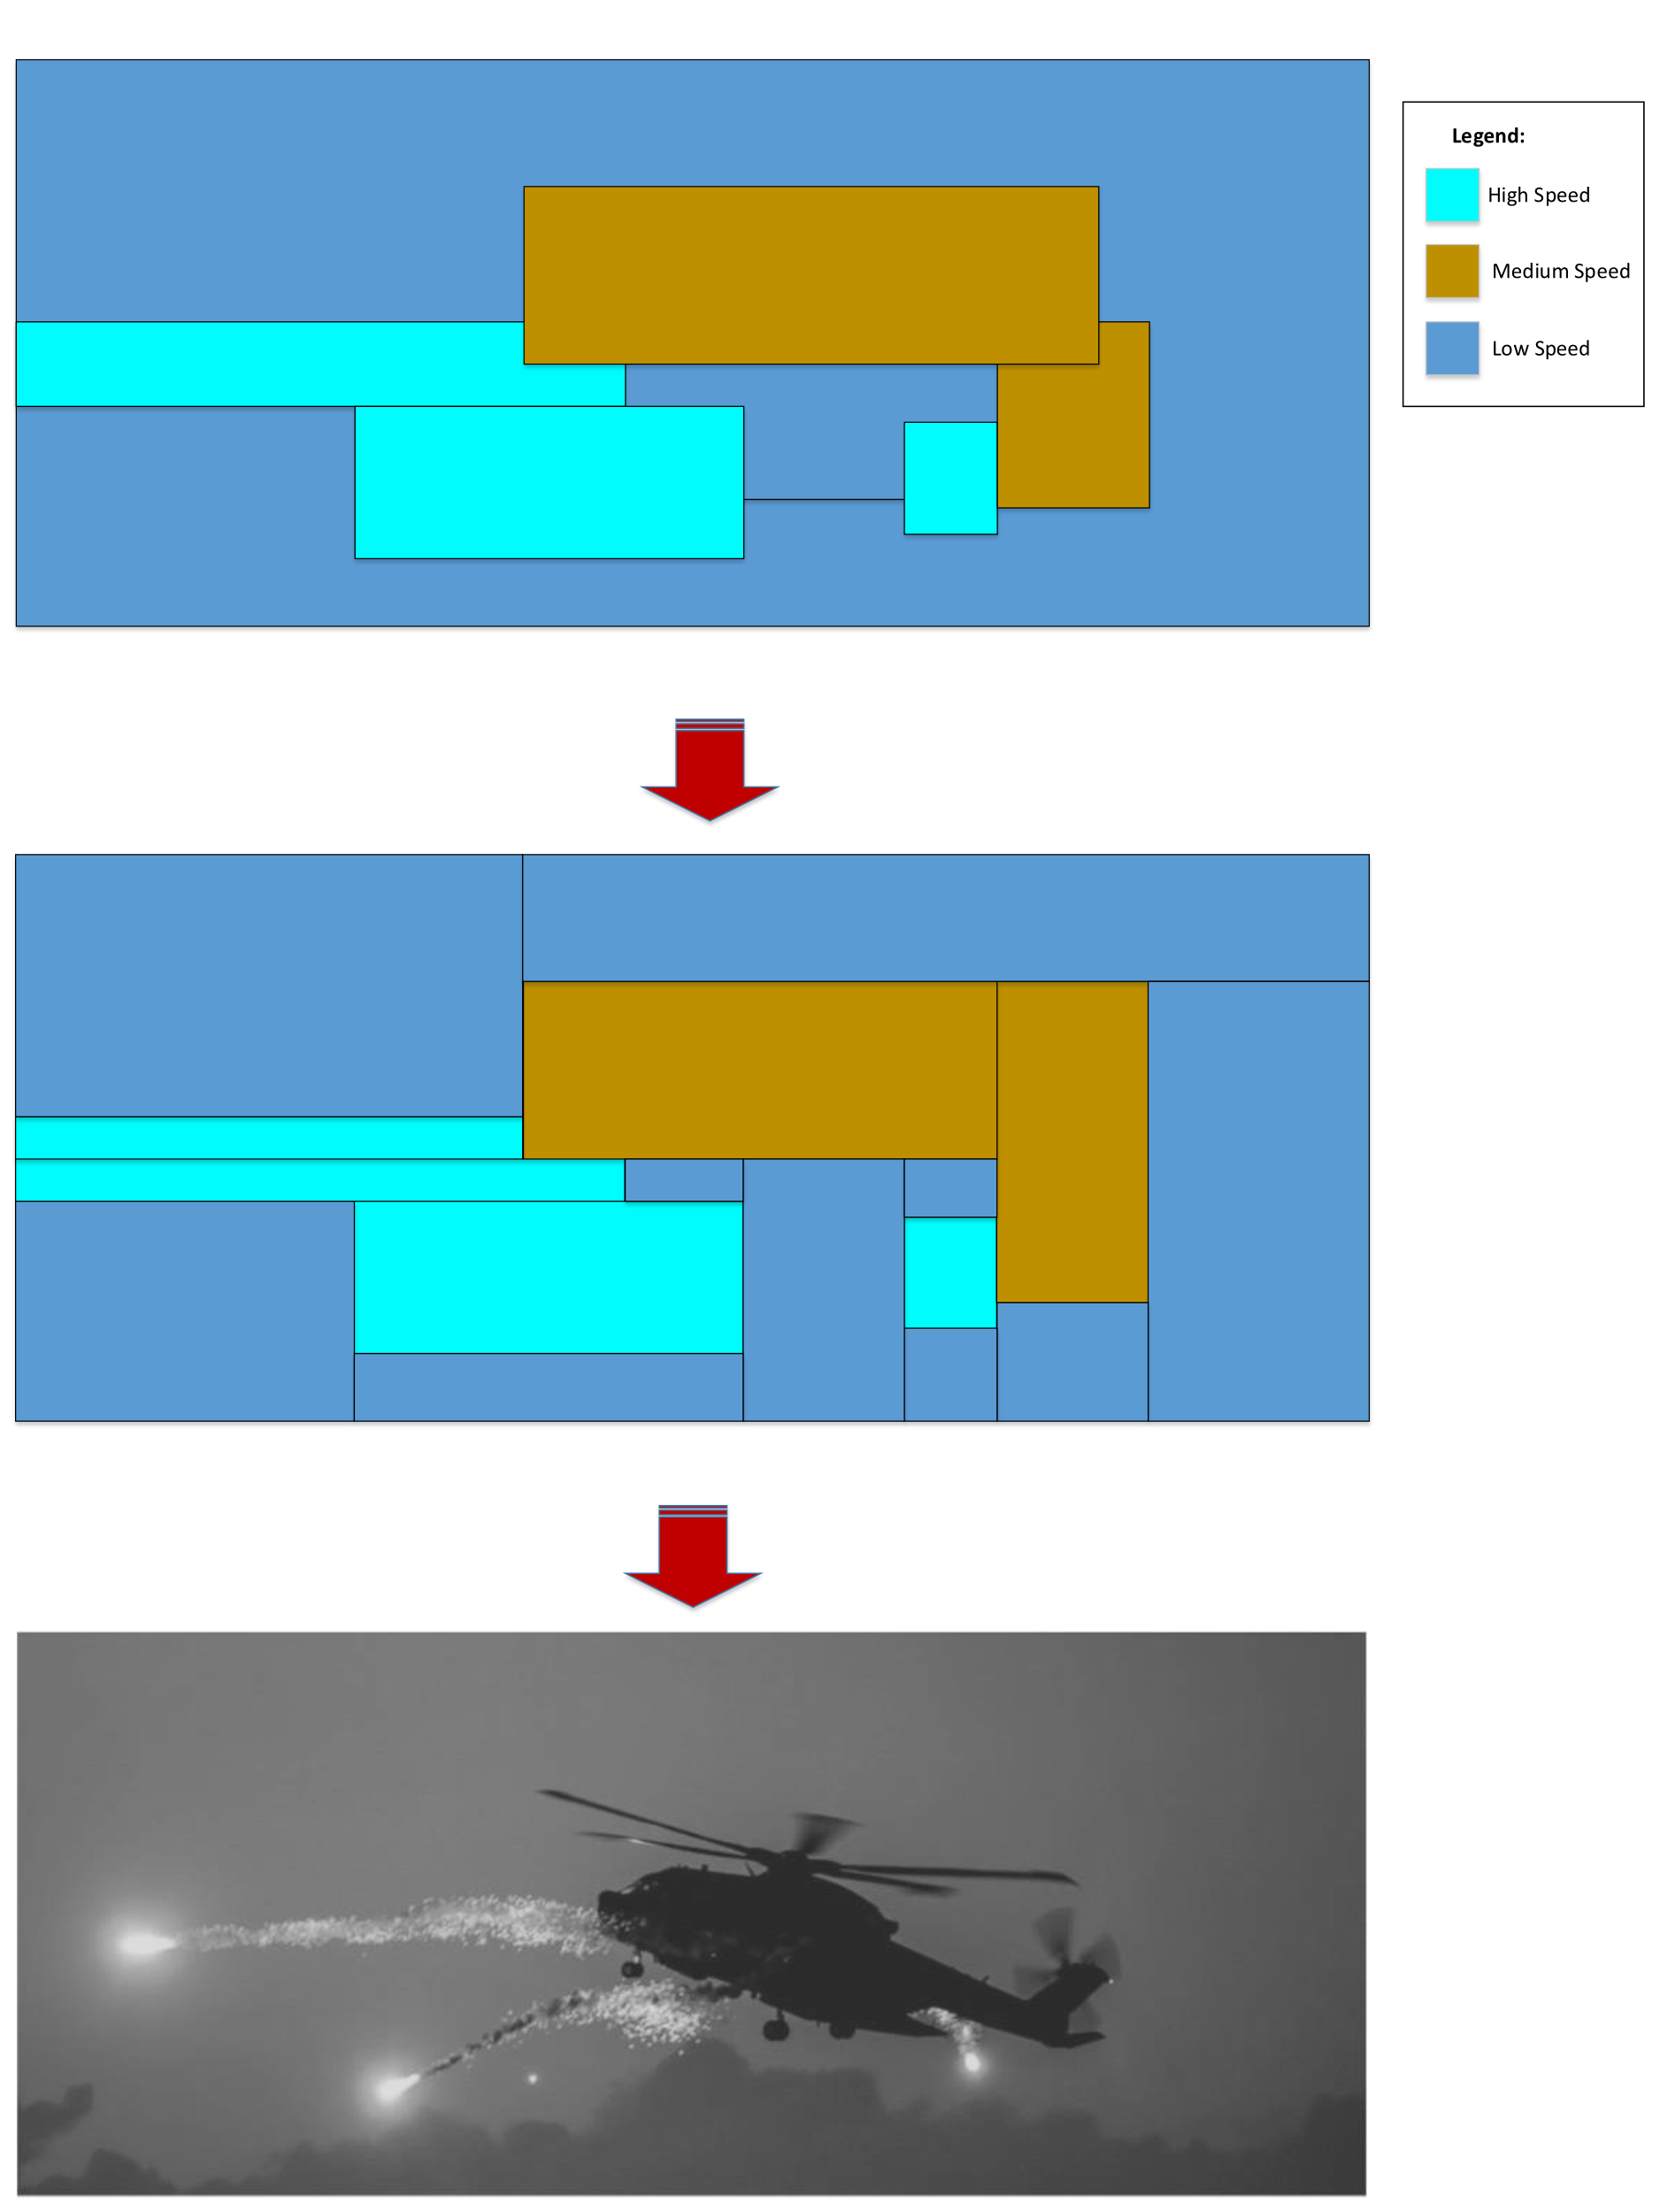
Compositing PDP
Composite frames and segmenting them
Change delta of frames
Relying on scene-generator to provide annotated priorities

Slide 105
Composited Together
Legend:
High Speed
Medium Speed
Low Speed
Video of Data (generated in parts or as a whole)
Segment frames into sub-frames
Each with variable frame operation

Slide 106
Prioritization
High changes in intensity give high priority.

